Slide 1
Airbnb
Phase - 2

Slide 2
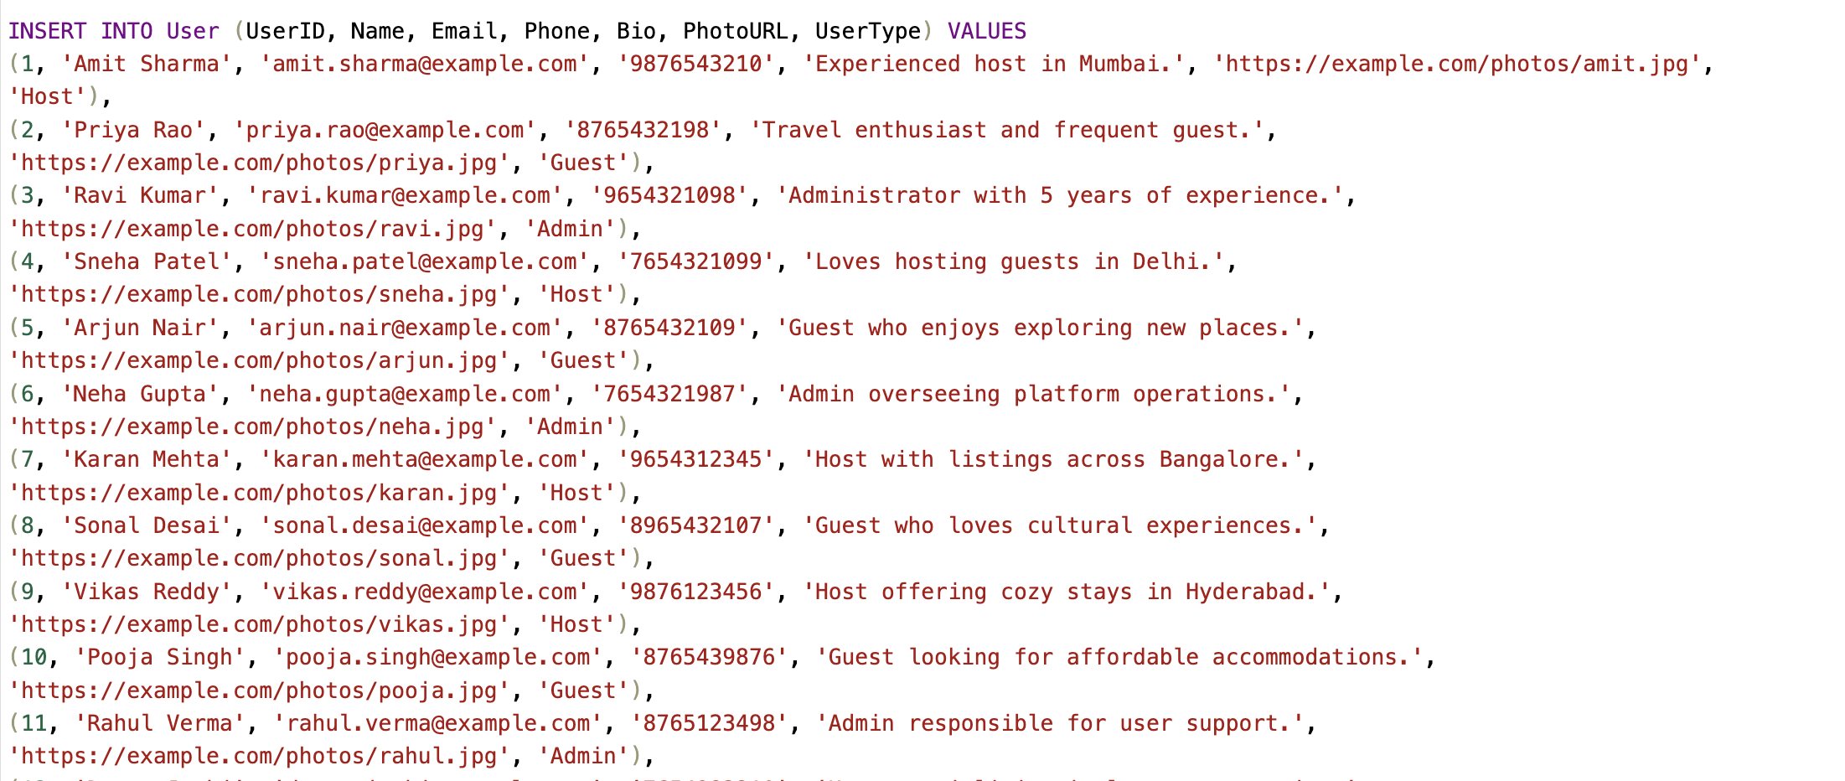
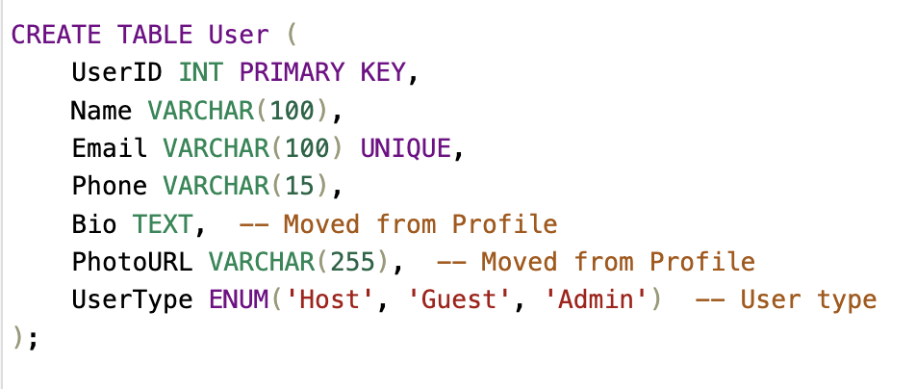
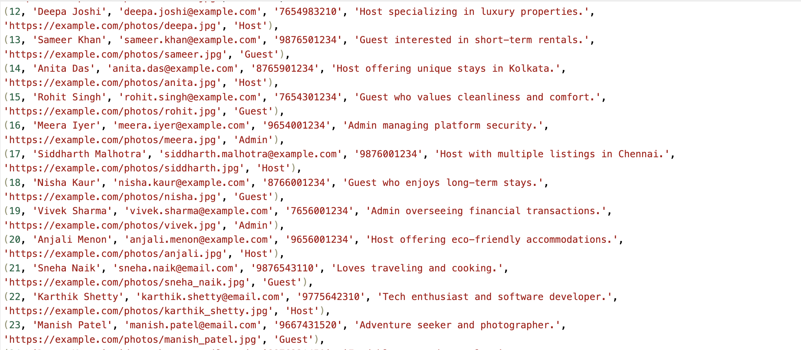
User
Use the SQL statement Create Table to define the structure of the User table
Use the SQL statement Insert Into 'User' to insert the values in the User table

Slide 3
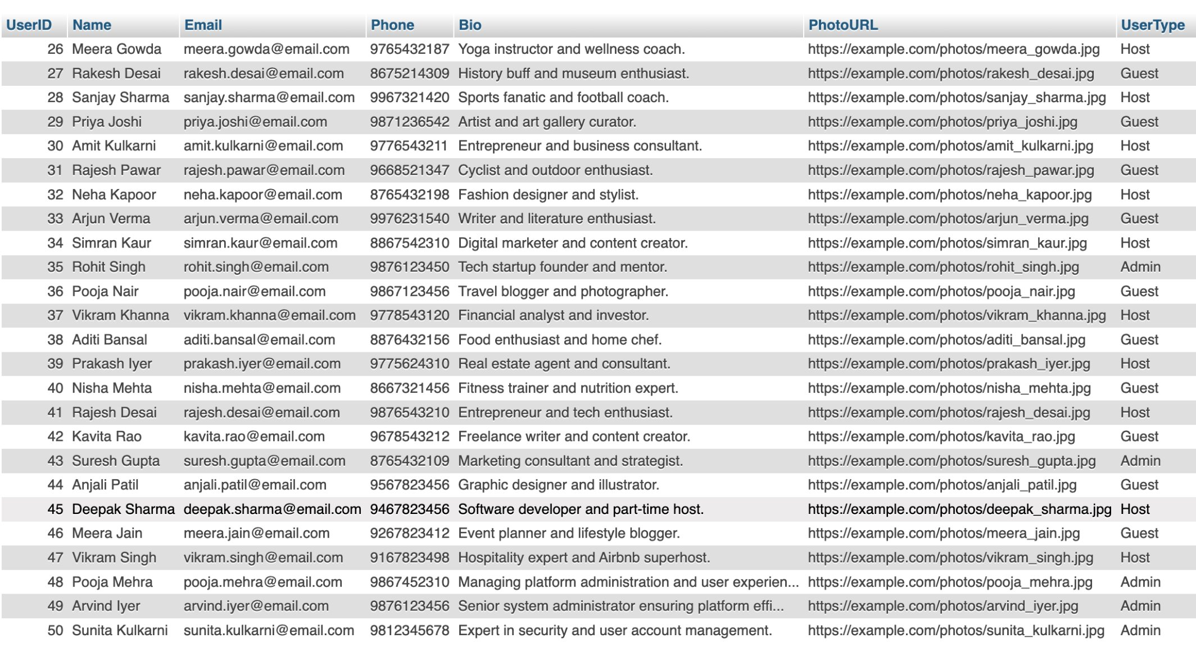
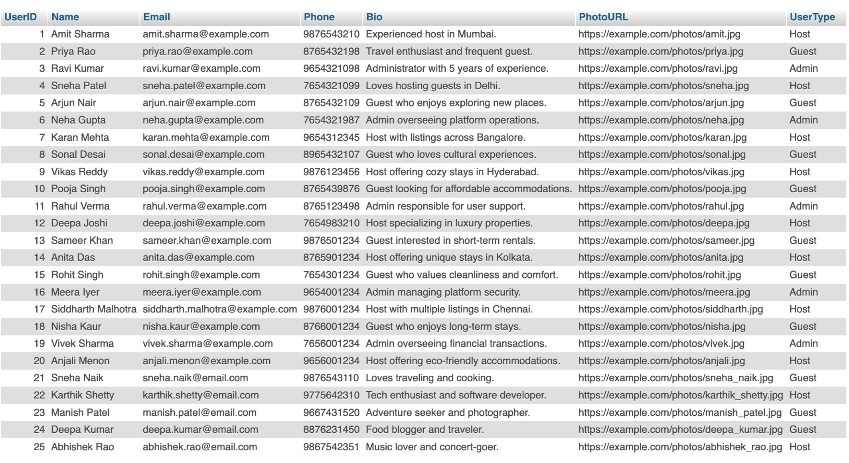
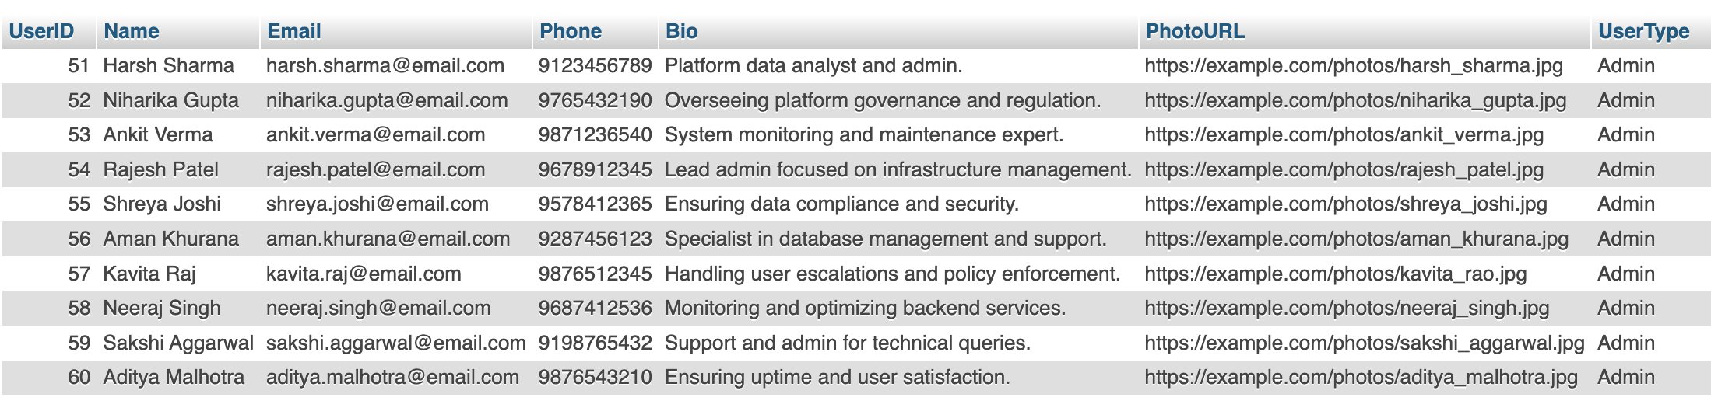
User

Slide 4
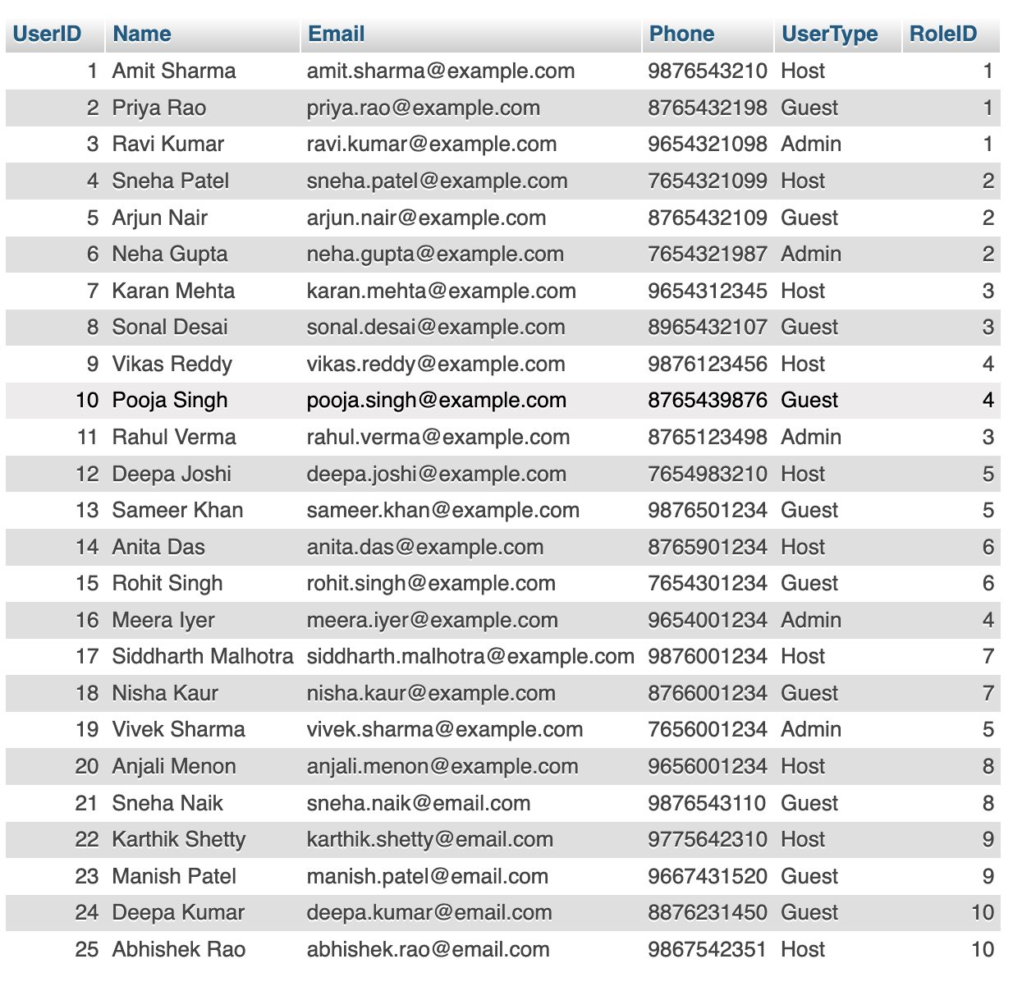
User: Test Case : To Show All Roles Together
SELECT U.UserID, U.Name, U.Email, U.Phone, U.UserType,
CASE
WHEN U.UserType = 'Host' THEN H.HostID
WHEN U.UserType = 'Guest' THEN G.GuestID
WHEN U.UserType = 'Admin' THEN A.AdminID
END AS RoleID
FROM User U
LEFT JOIN Host H ON U.UserID = H.UserID
LEFT JOIN Guest G ON U.UserID = G.UserID
LEFT JOIN Admin A ON U.UserID = A.UserID;
This query retrieves all users, whether they are a Host, Guest, or Admin.
It uses LEFT JOIN to ensure that even if a user is not a host, guest, or admin, their details still appear in the result.
It selects user details (UserID, Name, Email, Phone, UserType), along with the corresponding HostID, GuestID, and AdminID if applicable.
In this query, the CASE statement checks the UserType and then assigns the appropriate HostID, GuestID, or AdminID. This ensures that you only display the relevant role's ID based on the user type.

Slide 5
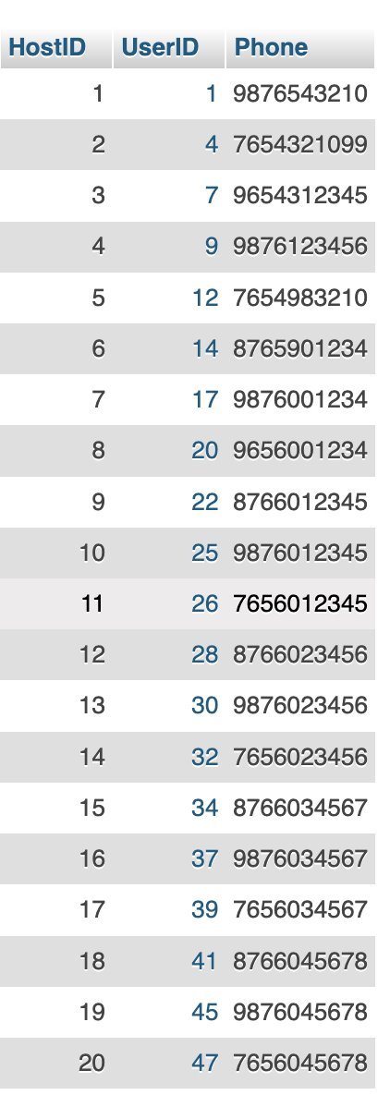
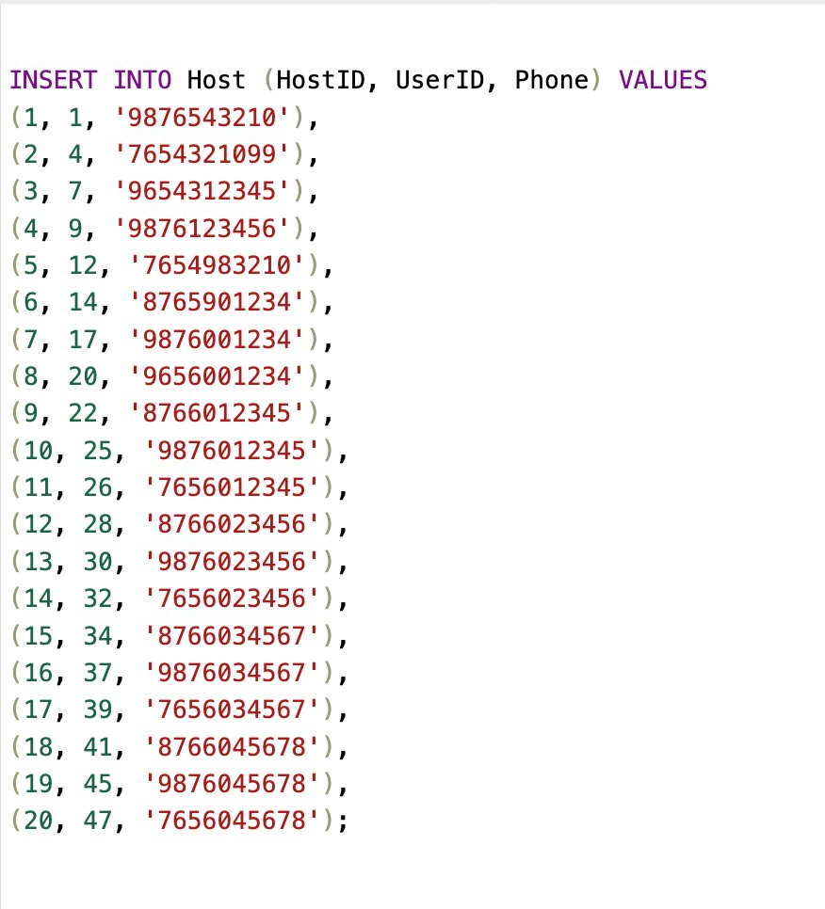
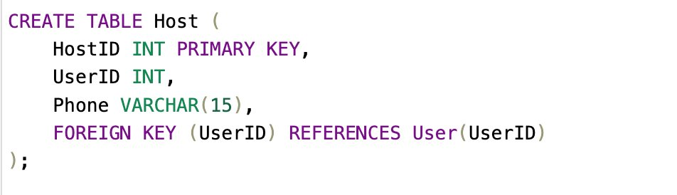
Host
Use the SQL statement Create Table to define the structure of the Host table
Use the SQL statement Insert Into 'Host' to insert the values in the Host table

Slide 6
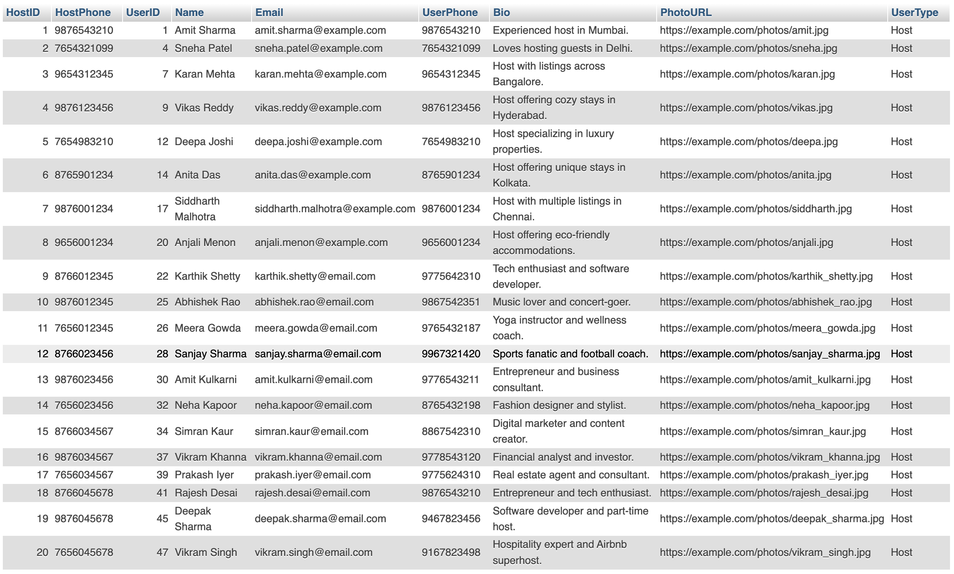
Host: Test Case : To Show Host Details
SELECT H.HostID, H.Phone AS HostPhone, U.UserID, U.Name, U.Email, U.Phone AS UserPhone, U.Bio, U.PhotoURL, U.UserType
FROM Host H
INNER JOIN User U ON H.UserID = U.UserID;
This query will return all hosts along with their respective user information. Since it's an INNER JOIN, it will only return the records where there is a matching UserID in both the Host and User tables.
H.HostID: Displays the HostID from the Host table.
H.Phone: Displays the host's phone number from the Host table.
U.UserID: Displays the user ID from the User table.
U.Name, U.Email, U.Phone, U.Bio, U.PhotoURL, U.UserType: Display respective fields from the User table.

Slide 7
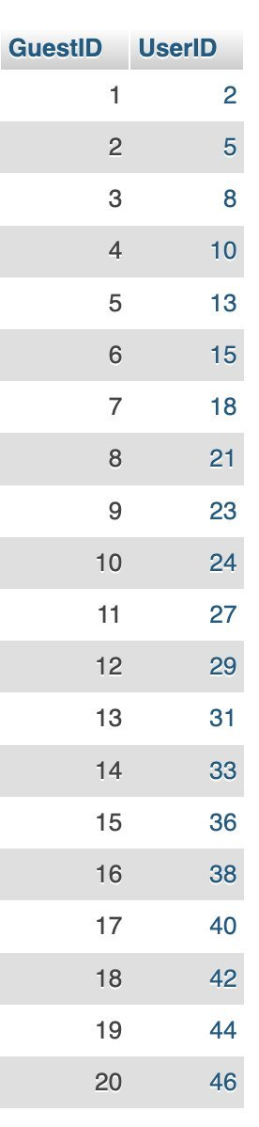
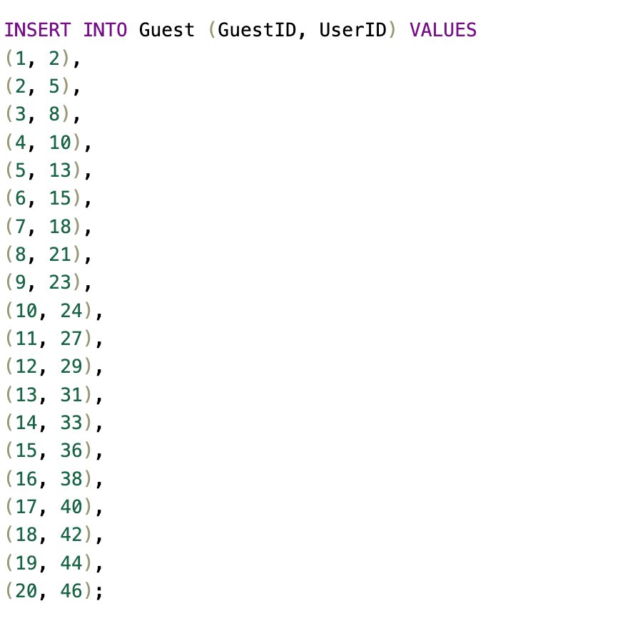
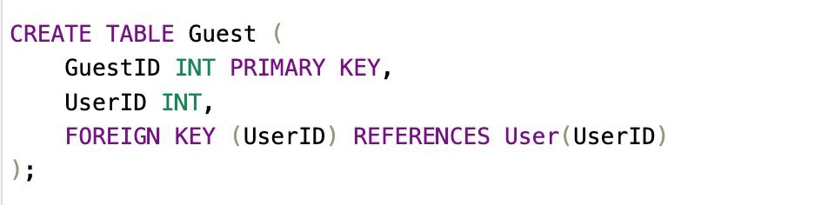
Guest
Use the SQL statement Create Table to define the structure of the Guest table
Use the SQL statement Insert Into 'Guest' to insert the values in the Guest table

Slide 8
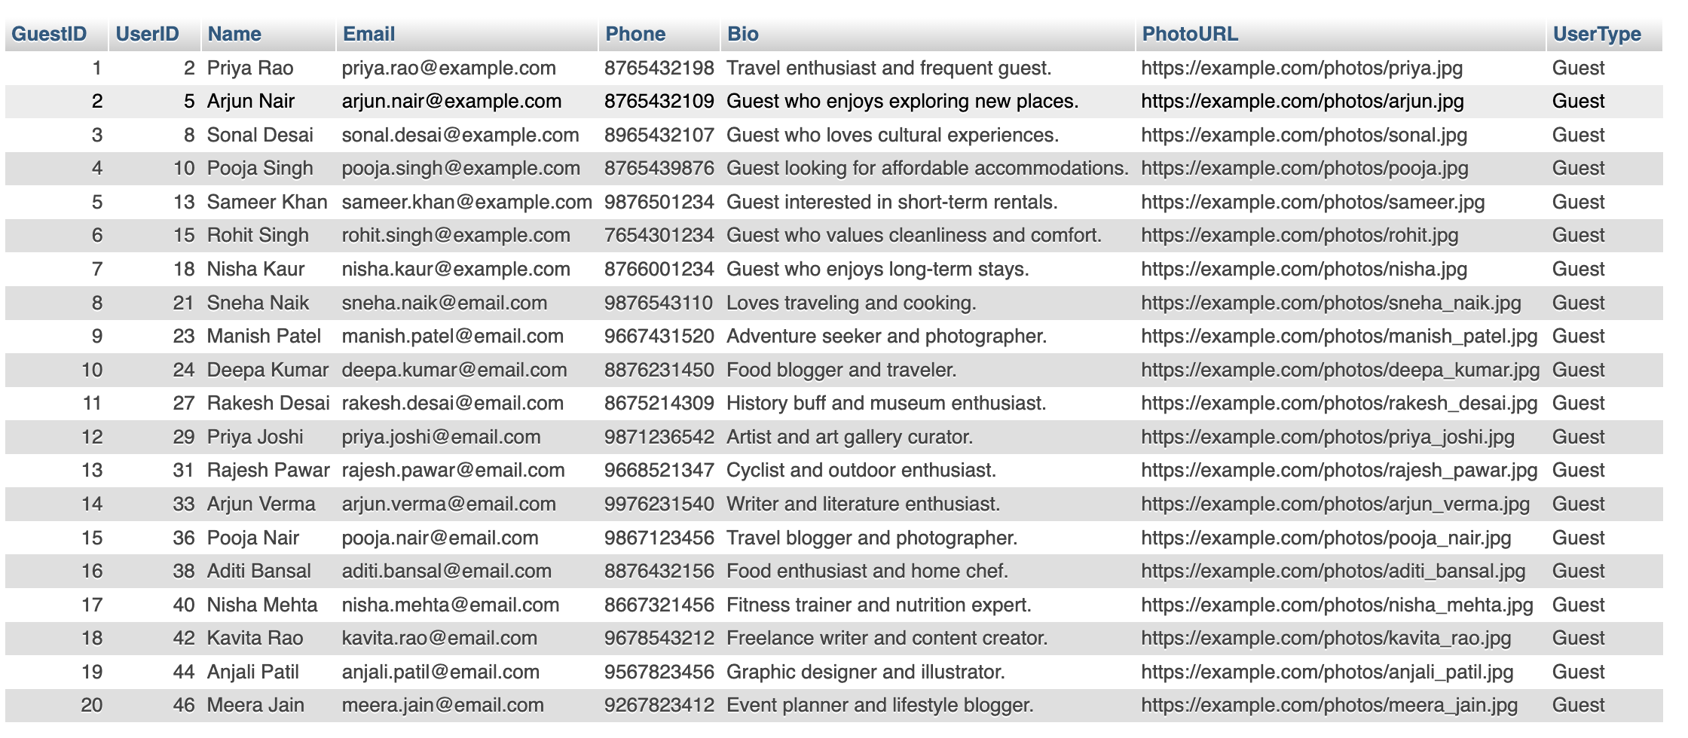
Guest: Test Case : To Show Guest Details
SELECT G.GuestID, U.UserID, U.Name, U.Email, U.Phone, U.Bio, U.PhotoURL, U.UserType
FROM Guest G
INNER JOIN User U ON G.UserID = U.UserID;
G.GuestID: Displays the GuestID from the Guest table.
U.UserID: Displays the user ID from the User table.
U.Name, U.Email, U.Phone, U.Bio, U.PhotoURL, U.UserType: Display respective fields from the User table.
This should return all guests along with their corresponding user details from the User table.

Slide 9
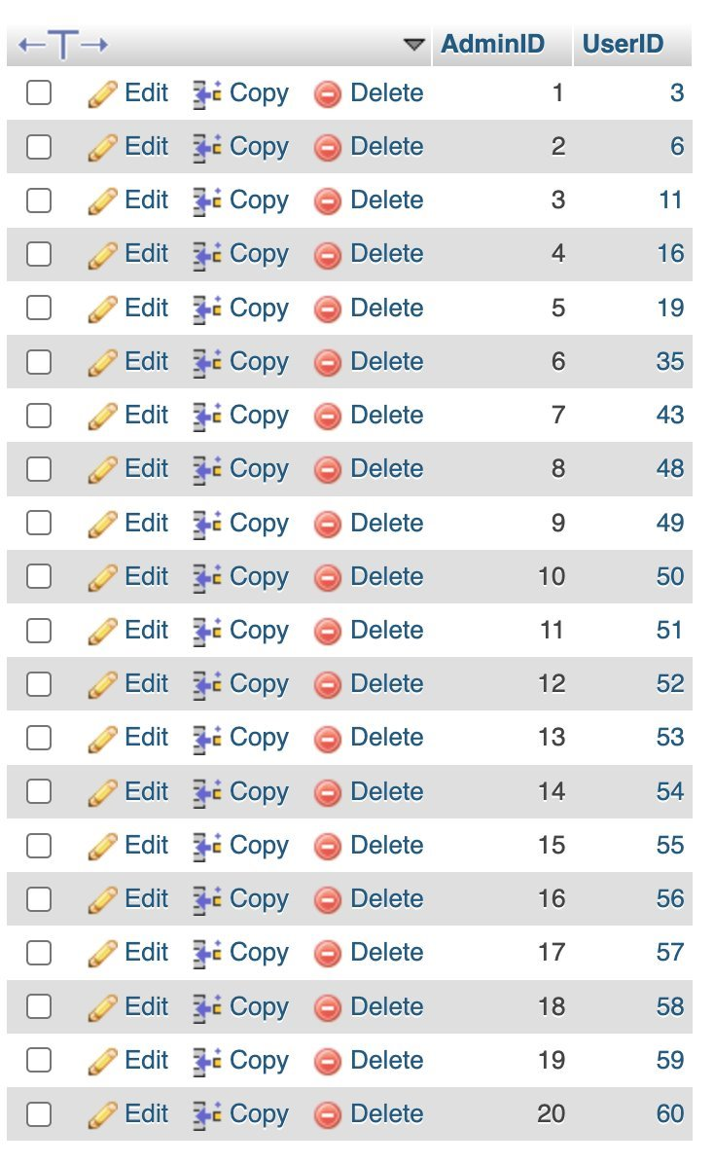
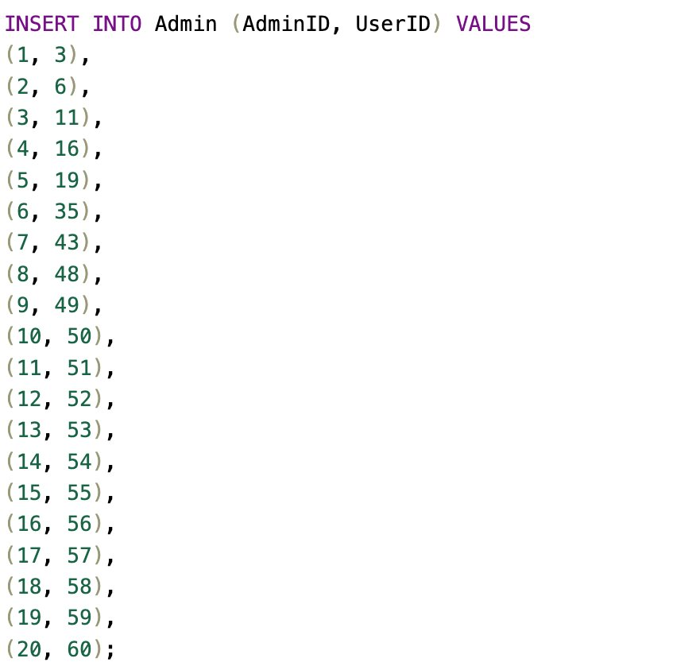
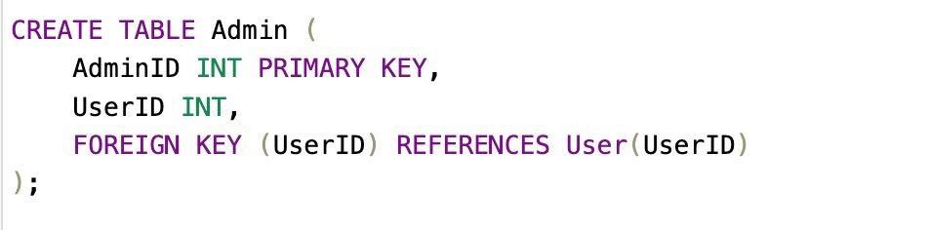
Admin
Use the SQL statement Create Table to define the structure of the Admin table
Use the SQL statement Insert Into 'Admin' to insert the values in the Admin table

Slide 10
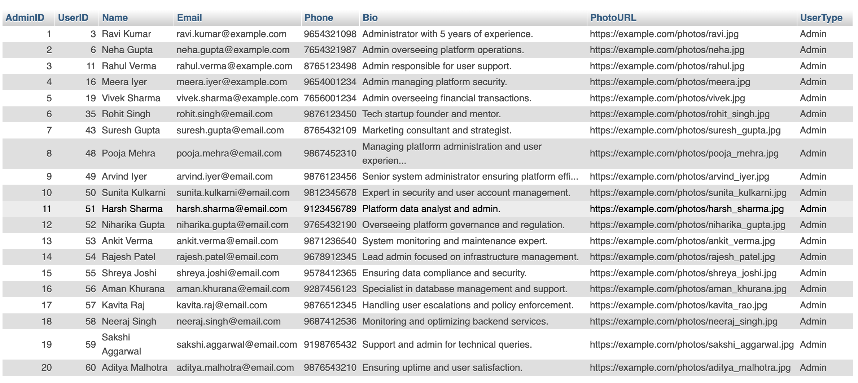
Admin: Test Case : To Show Admin Details
SELECT A.AdminID, U.UserID, U.Name, U.Email, U.Phone, U.Bio, U.PhotoURL, U.UserType
FROM Admin A
INNER JOIN User U ON A.UserID = U.UserID;
A.AdminID: Displays the AdminID from the Admin table.
U.UserID: Displays the user ID from the User table.
U.Name, U.Email, U.Phone, U.Bio, U.PhotoURL, U.UserType: Display respective fields from the User table.
This should return all admins along with their corresponding user details from the User table.

Slide 11
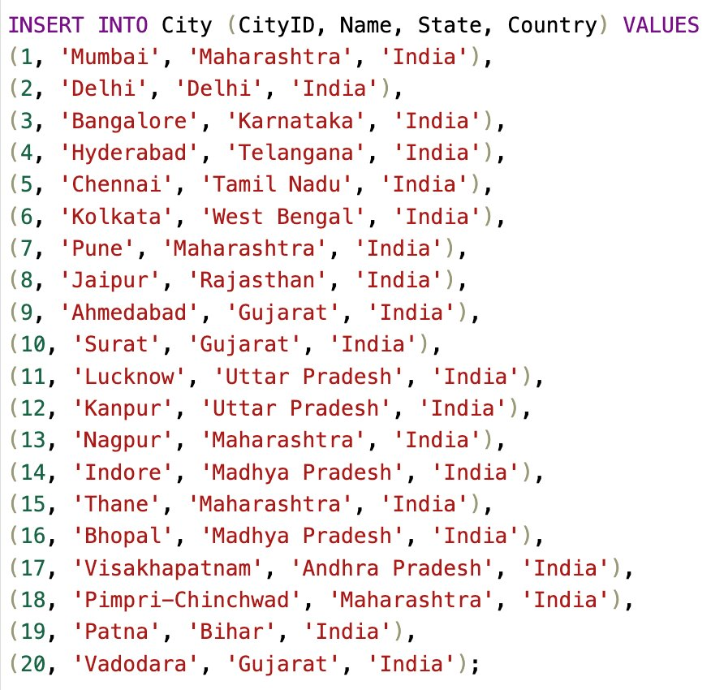
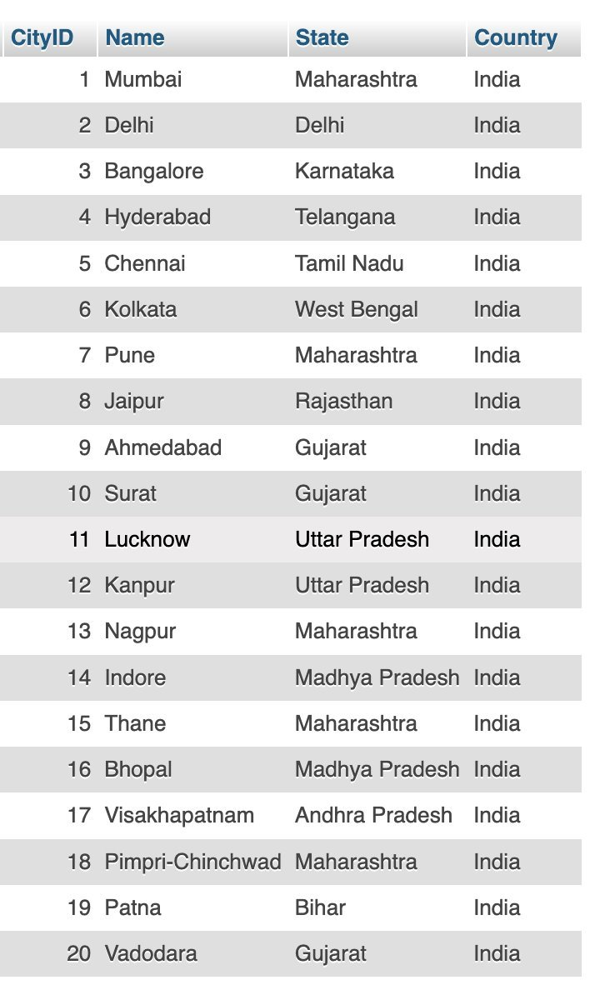
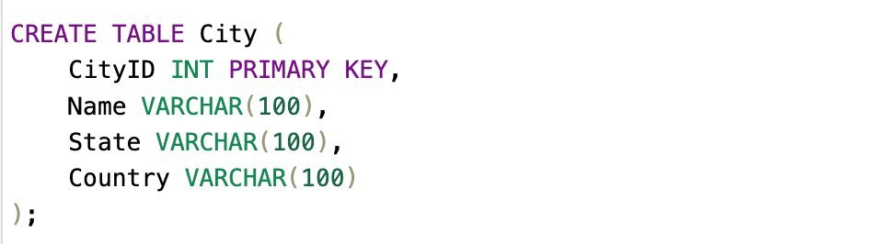
City
Use the SQL statement Create Table to define the structure of the City table
Use the SQL statement Insert Into 'City' to insert the values in the City table

Slide 12
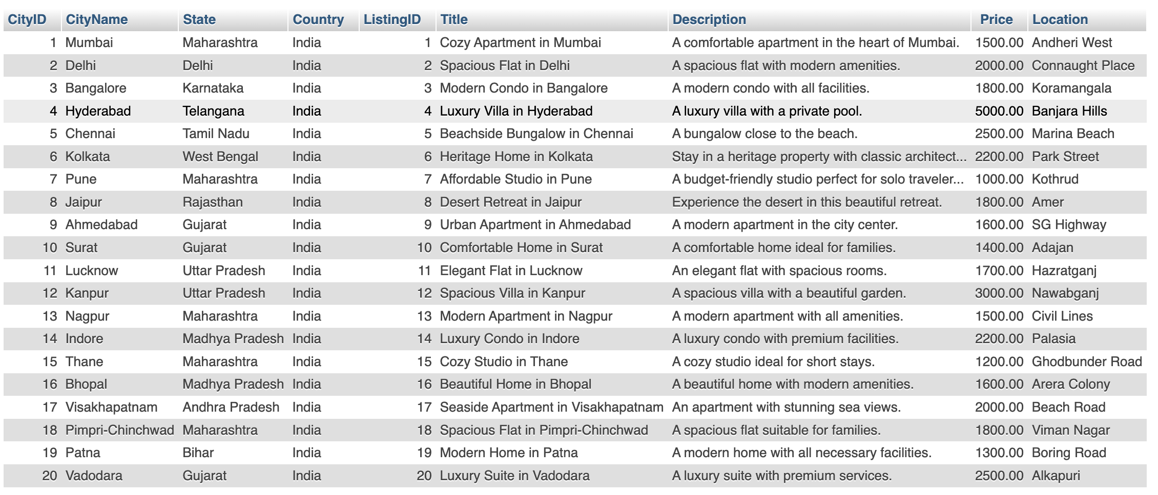
City: Test Case : To Show City Details
SELECT C.CityID, C.Name AS CityName, C.State, C.Country, L.ListingID, L.Title, L.Description, L.Price, L.Location
FROM City C
INNER JOIN Listing L ON C.CityID = L.CityID;
C.CityID: Displays the CityID from the City table.
C.Name: Displays the city name.
C.State, C.Country: Display state and country from the City table.
L.ListingID: Displays the ListingID from the Listing table.
L.Title, L.Description, L.Price, L.Location: Display listing details from the Listing table that are associated with the city.
This query will return city details and all the listings available in each city.

Slide 13
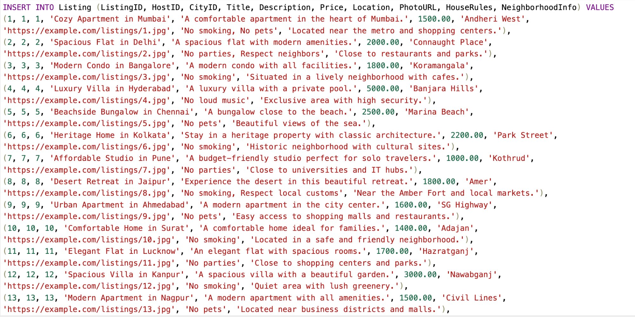
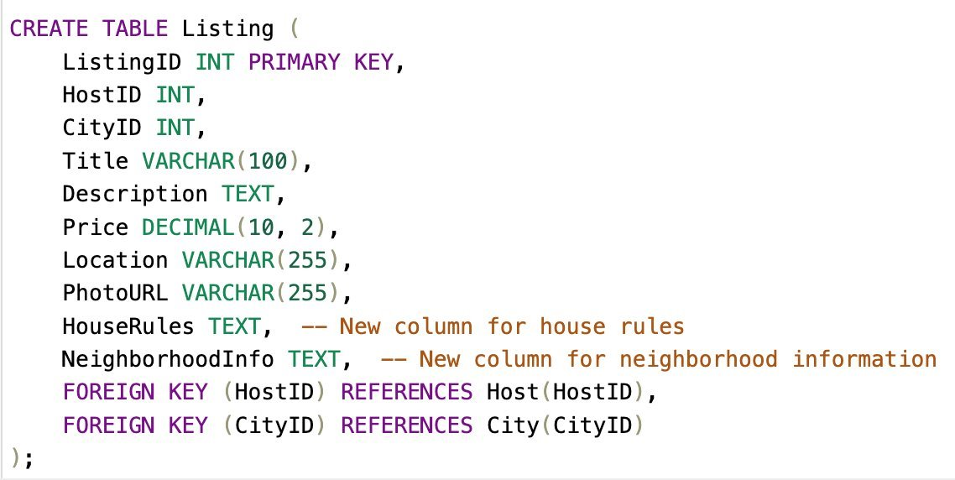
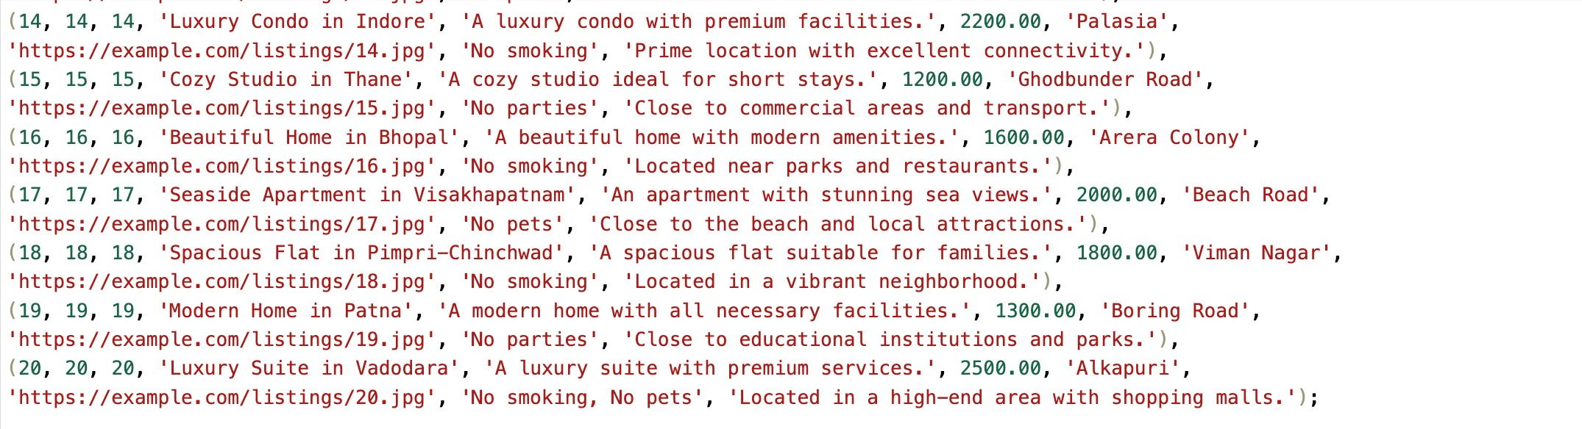
Listing
Use the SQL statement Create Table to define the structure of the Listing table
Use the SQL statement Insert Into 'Listing' to insert the values in the Listing table

Slide 14
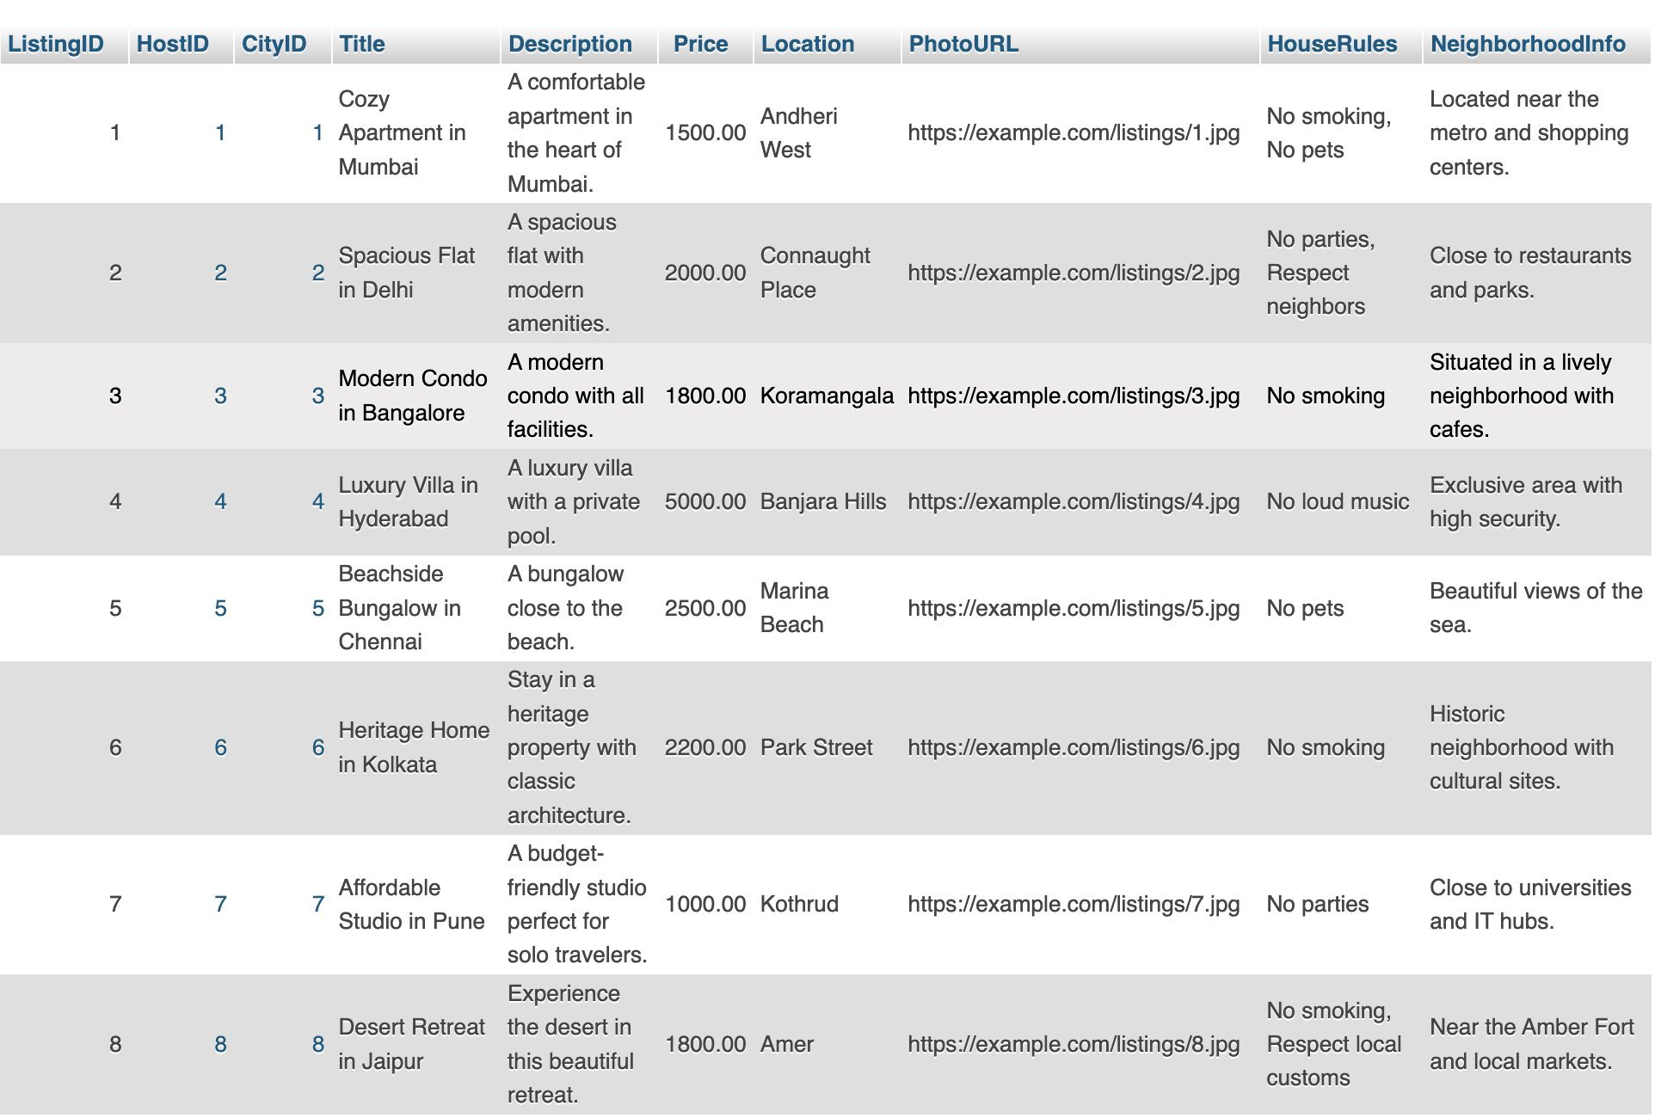
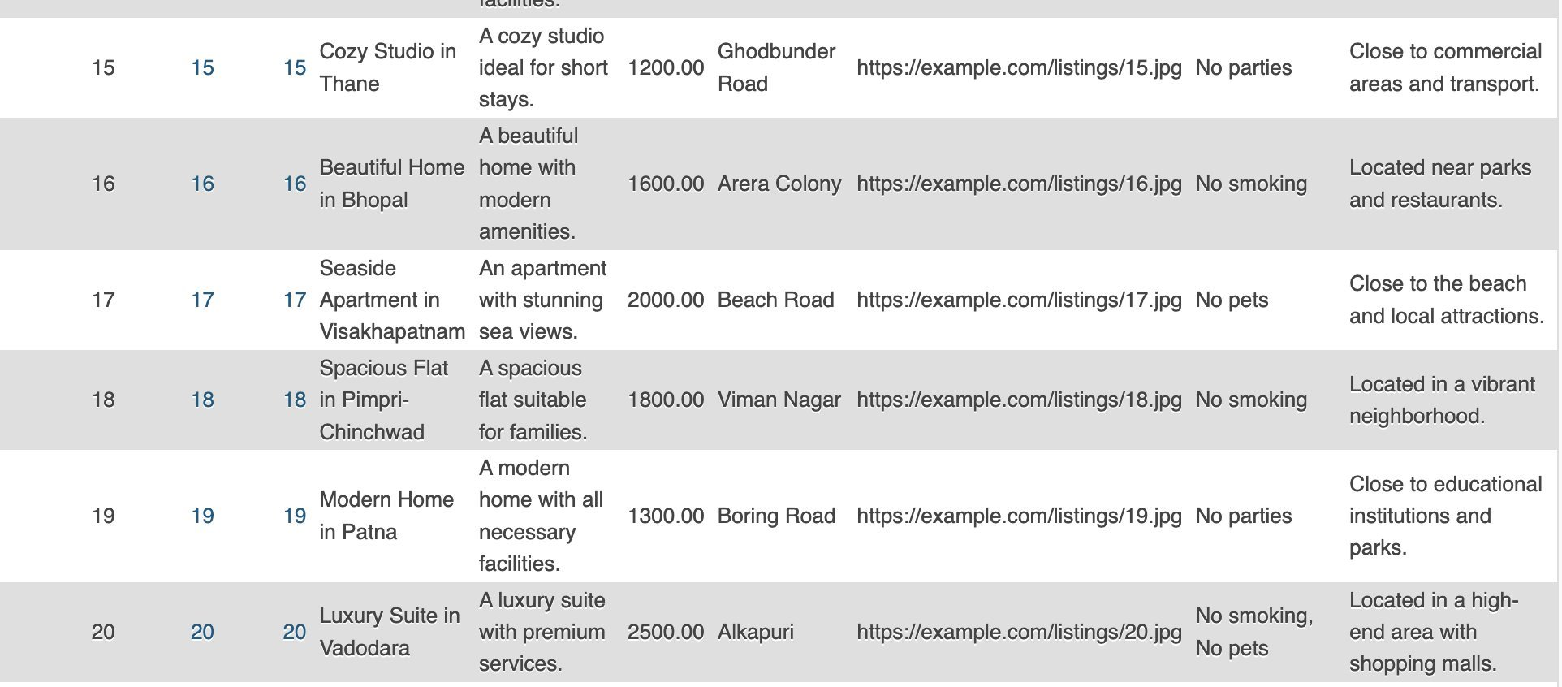
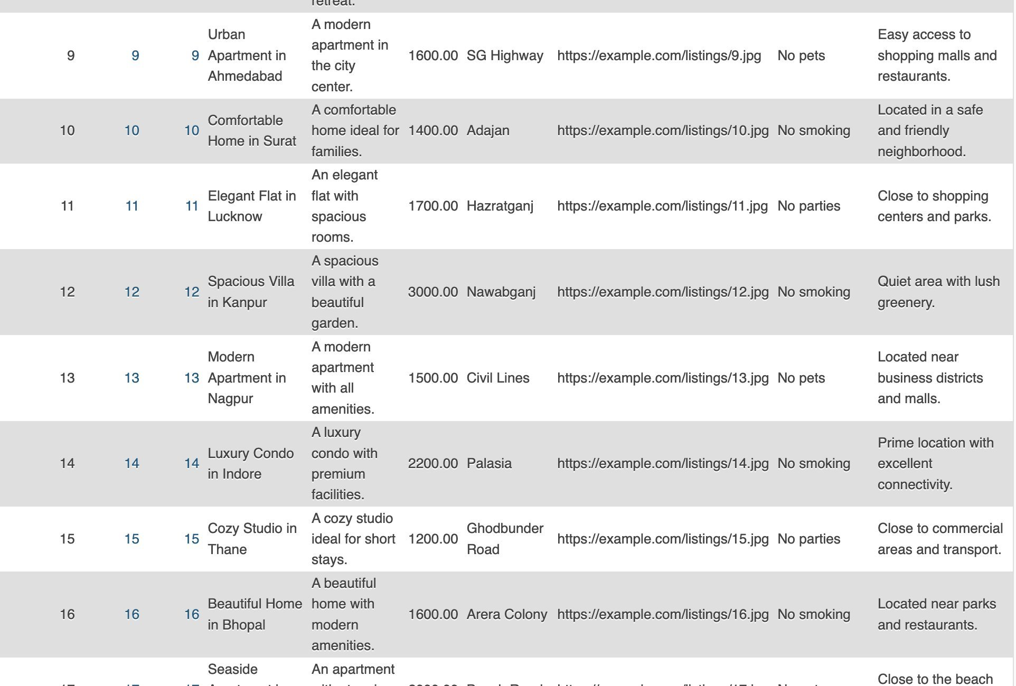
Listing

Slide 15
Listing: Test Case : To Show Listing Details
SELECT L.ListingID, L.Title, L.Description, L.Price, L.Location, L.PhotoURL, L.HouseRules, L.NeighborhoodInfo,
H.HostID, U.Name AS HostName, U.Email AS HostEmail, U.Phone AS HostPhone,
C.CityID, C.Name AS CityName, C.State, C.Country
FROM Listing L
INNER JOIN Host H ON L.HostID = H.HostID
INNER JOIN User U ON H.UserID = U.UserID
INNER JOIN City C ON L.CityID = C.CityID;
L.ListingID, L.Title, L.Description, L.Price, L.Location, L.PhotoURL, L.HouseRules, L.NeighborhoodInfo: Display listing details from the Listing table.
H.HostID: Retrieves the corresponding HostID from the Host table.
U.Name, U.Email, U.Phone: Retrieves the host's name, email, and phone from the User table (since hosts are also users).
C.CityID, C.Name, C.State, C.Country: Retrieves the city details (name, state, and country) from the City table.
This query will return listing details along with information about the host and the city where the listing is located.

Slide 16
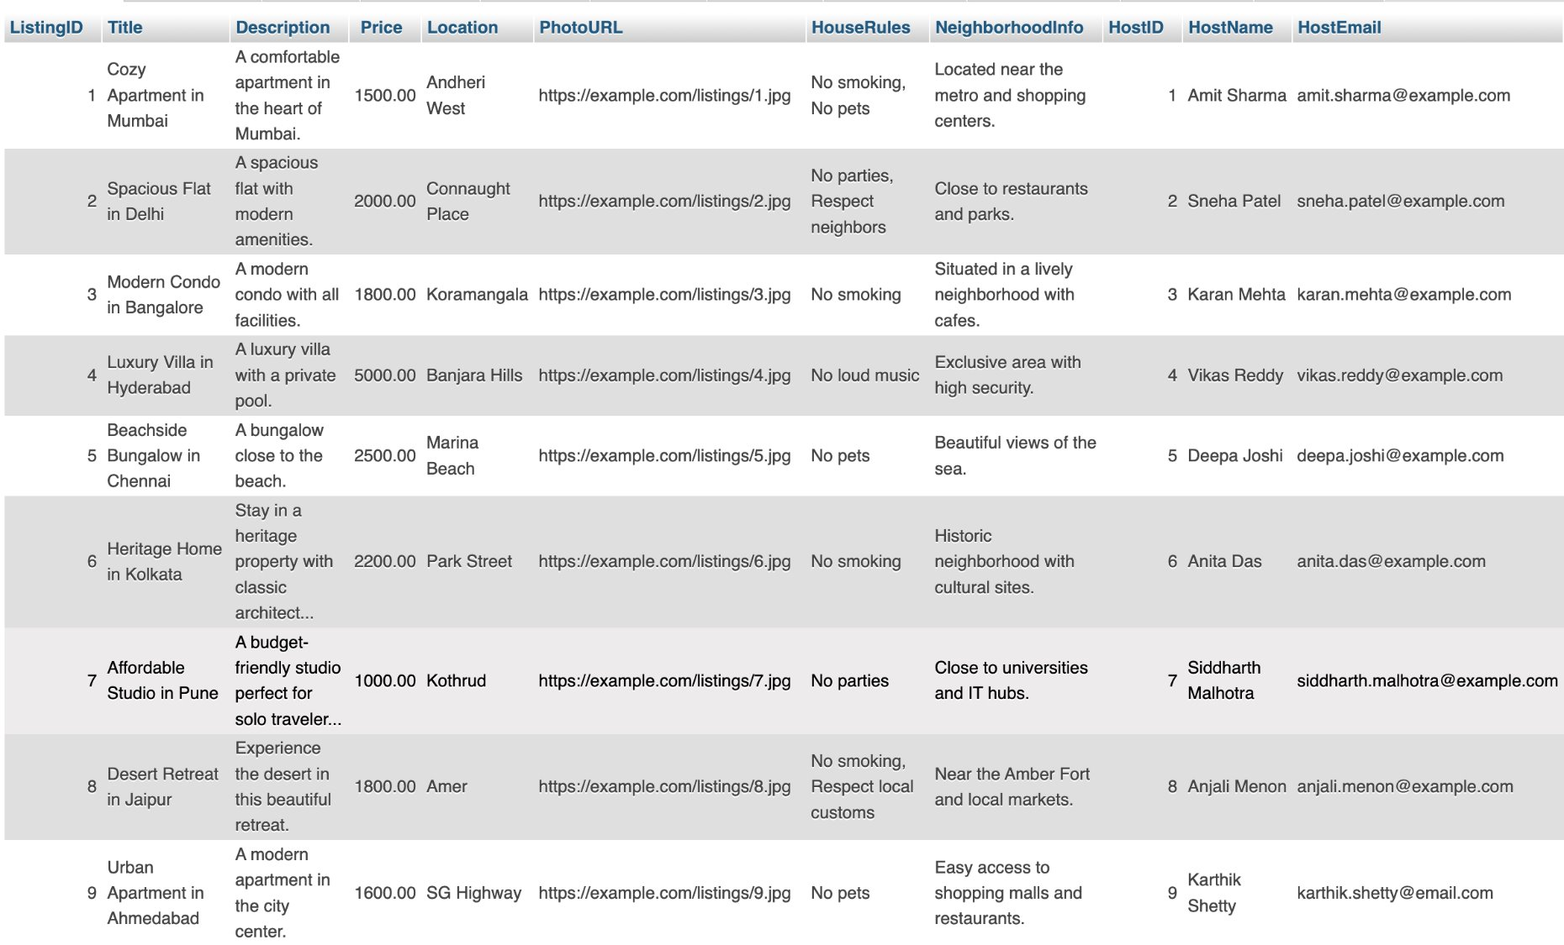
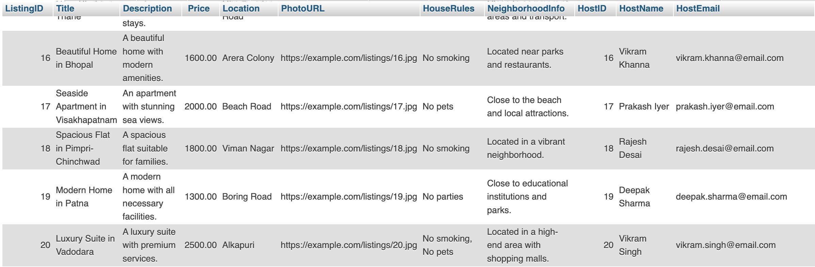
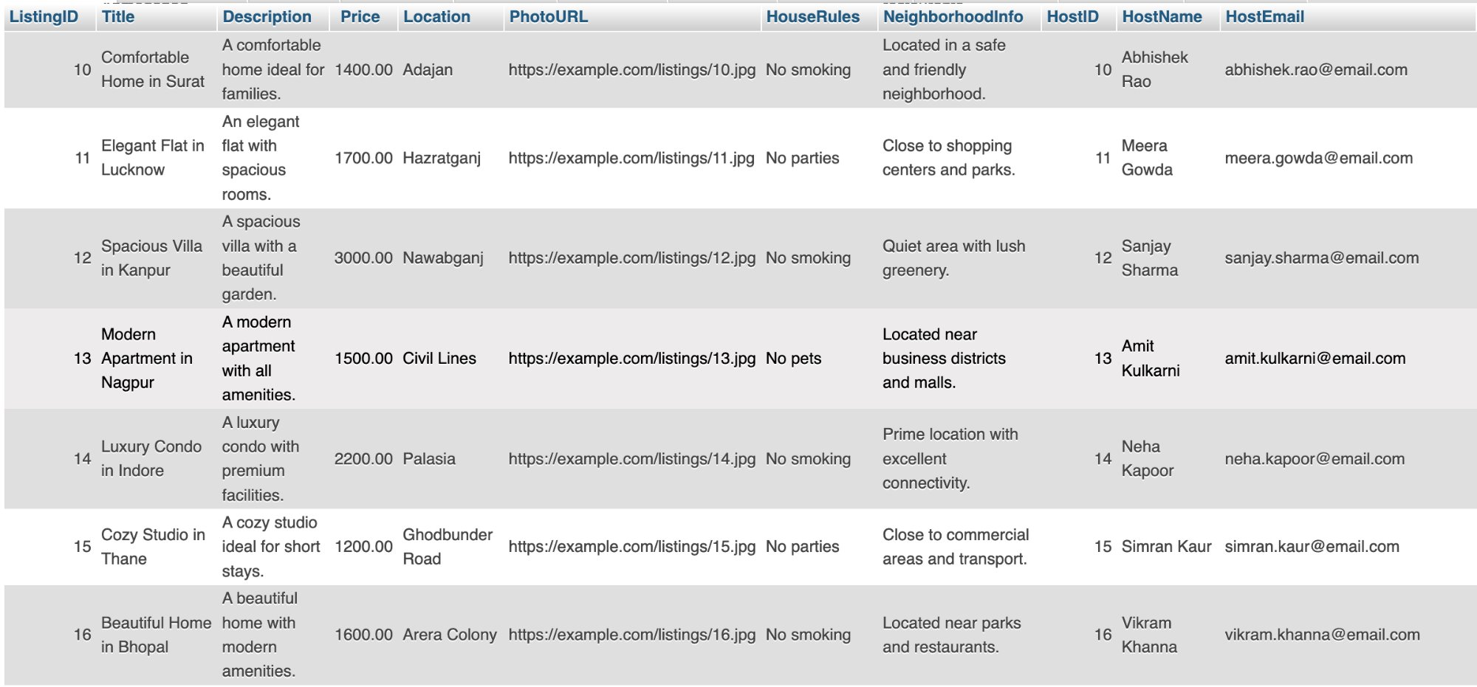
Listing: Test Case : To Show Listing Details

Slide 17
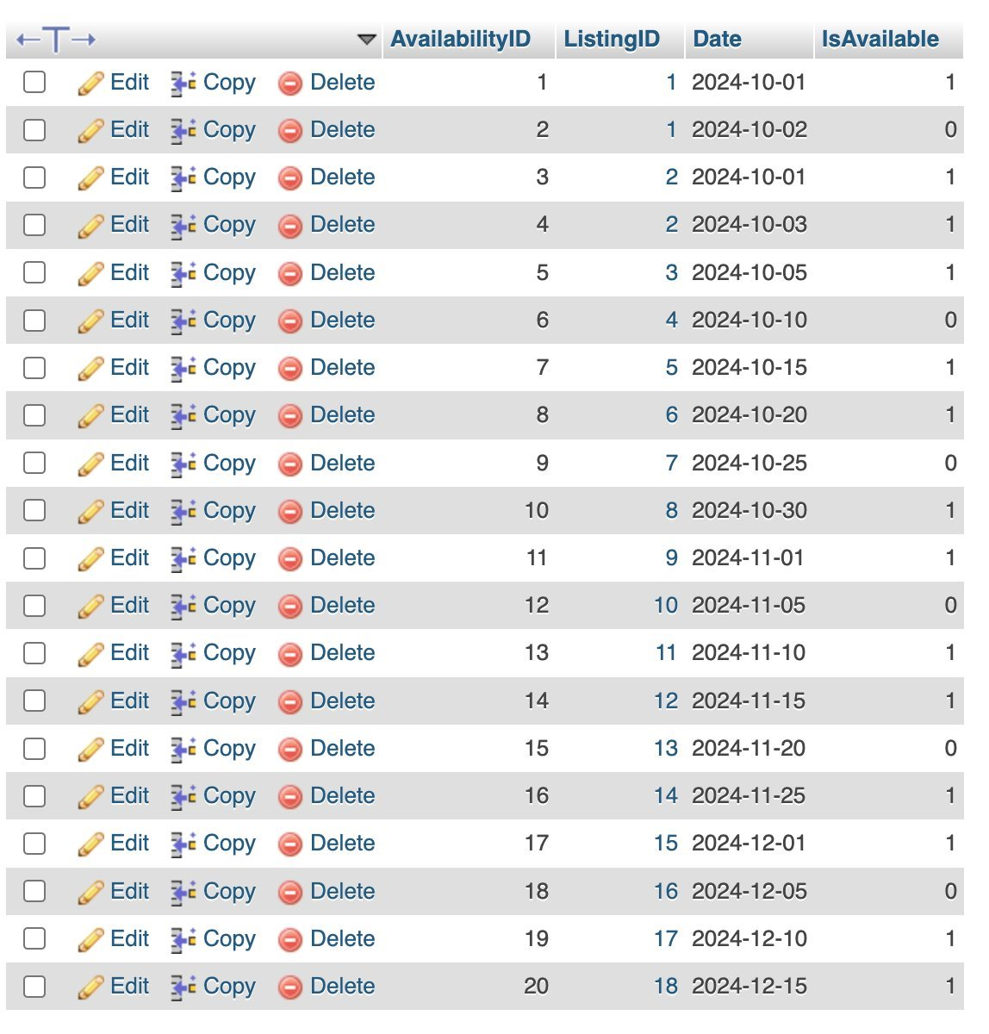
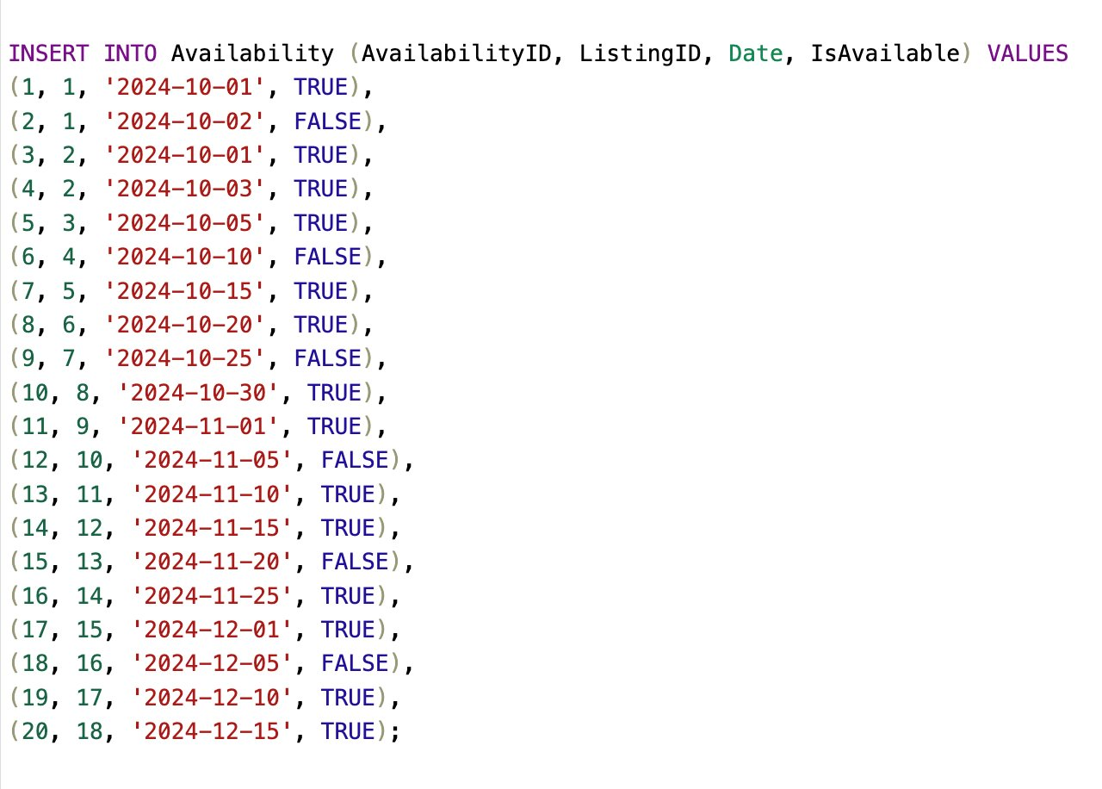
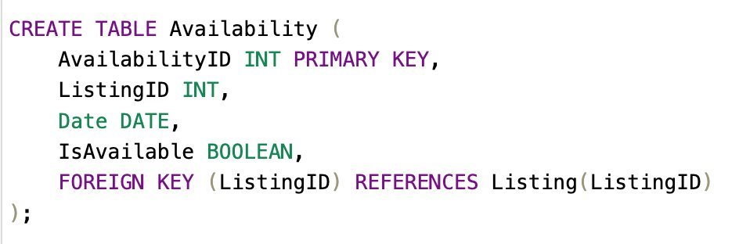
Availability
Use the SQL statement Create Table to define the structure of the Availability table
Use the SQL statement Insert Into 'Availability' to insert the values in the Availability table

Slide 18
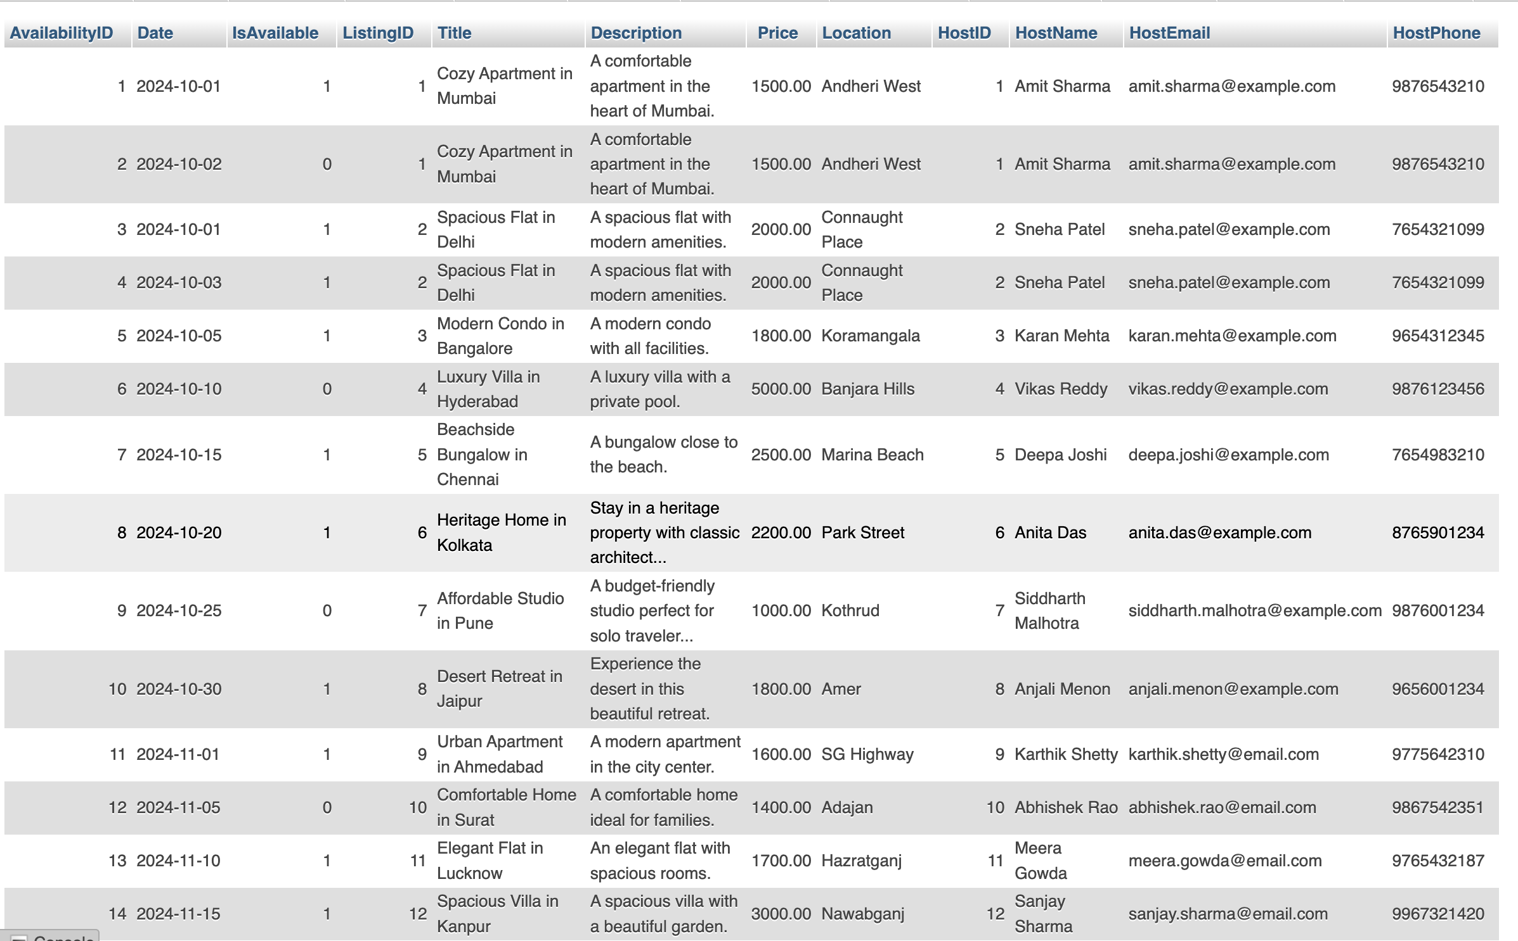
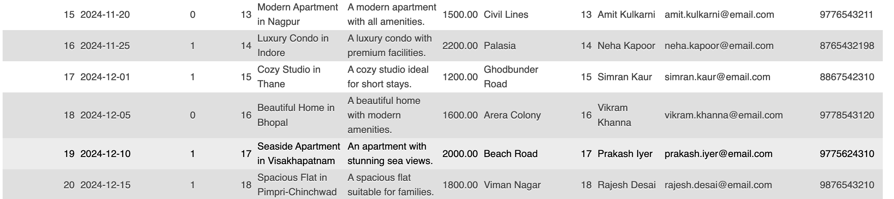
Availability: Test Case : To Show Availability Details
SELECT A.AvailabilityID, A.Date, A.IsAvailable,
L.ListingID, L.Title, L.Description, L.Price, L.Location,
H.HostID, U.Name AS HostName, U.Email AS HostEmail, U.Phone AS HostPhone
FROM Availability A
INNER JOIN Listing L ON A.ListingID = L.ListingID
INNER JOIN Host H ON L.HostID = H.HostID
INNER JOIN User U ON H.UserID = U.UserID;
A.AvailabilityID, A.Date, A.IsAvailable: Retrieves availability details from the Availability table.
L.ListingID, L.Title, L.Description, L.Price, L.Location: Retrieves listing details from the Listing table.
H.HostID: Retrieves the corresponding HostID from the Host table.
U.Name, U.Email, U.Phone: Retrieves the host's name, email, and phone from the User table (since hosts are users).
This query will return availability details along with the listing and host information associated with that availability.

Slide 19
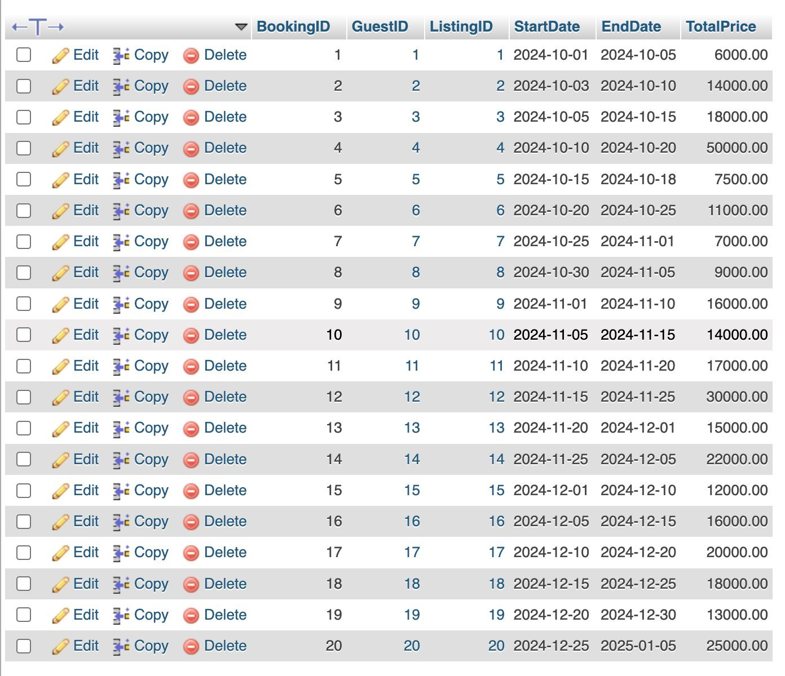
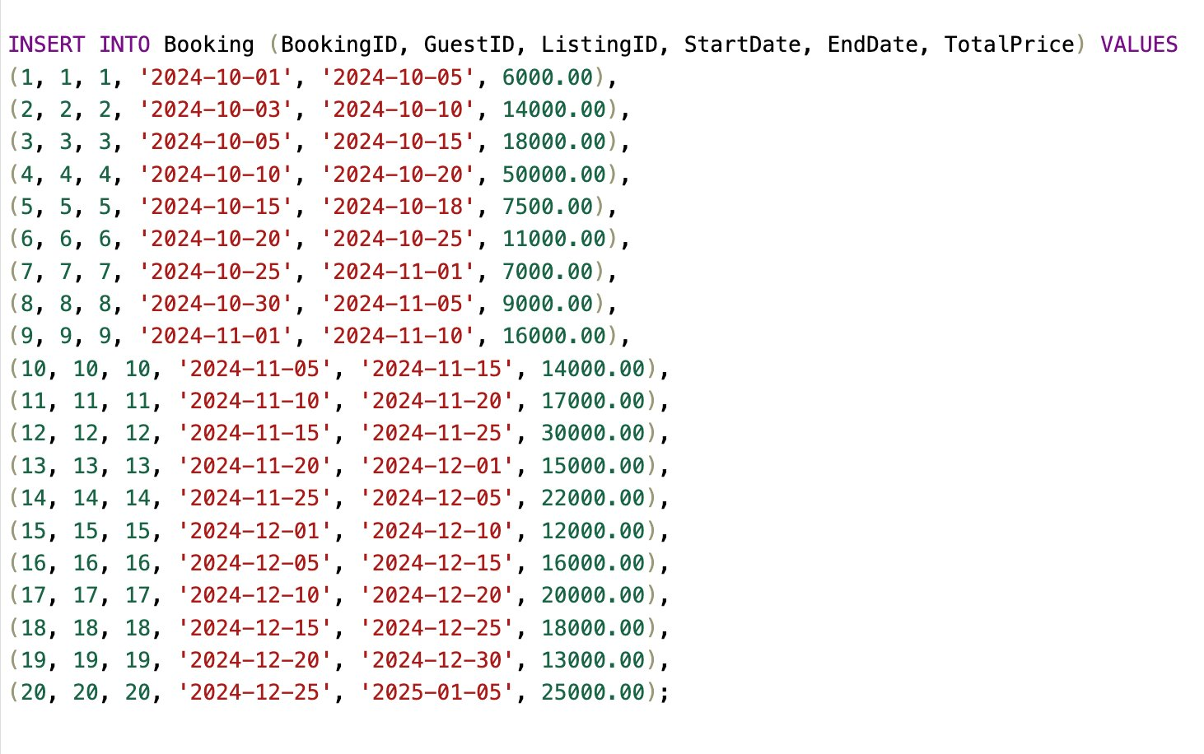
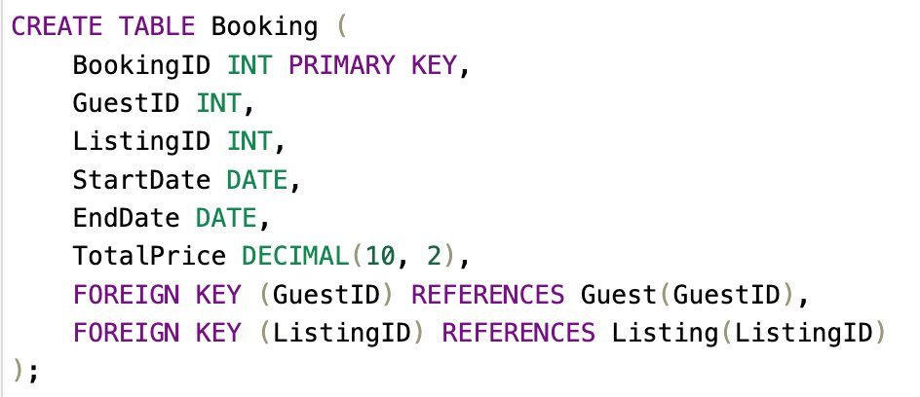
Booking
Use the SQL statement Create Table to define the structure of the Booking table
Use the SQL statement Insert Into 'Booking' to insert the values in the Booking table

Slide 20
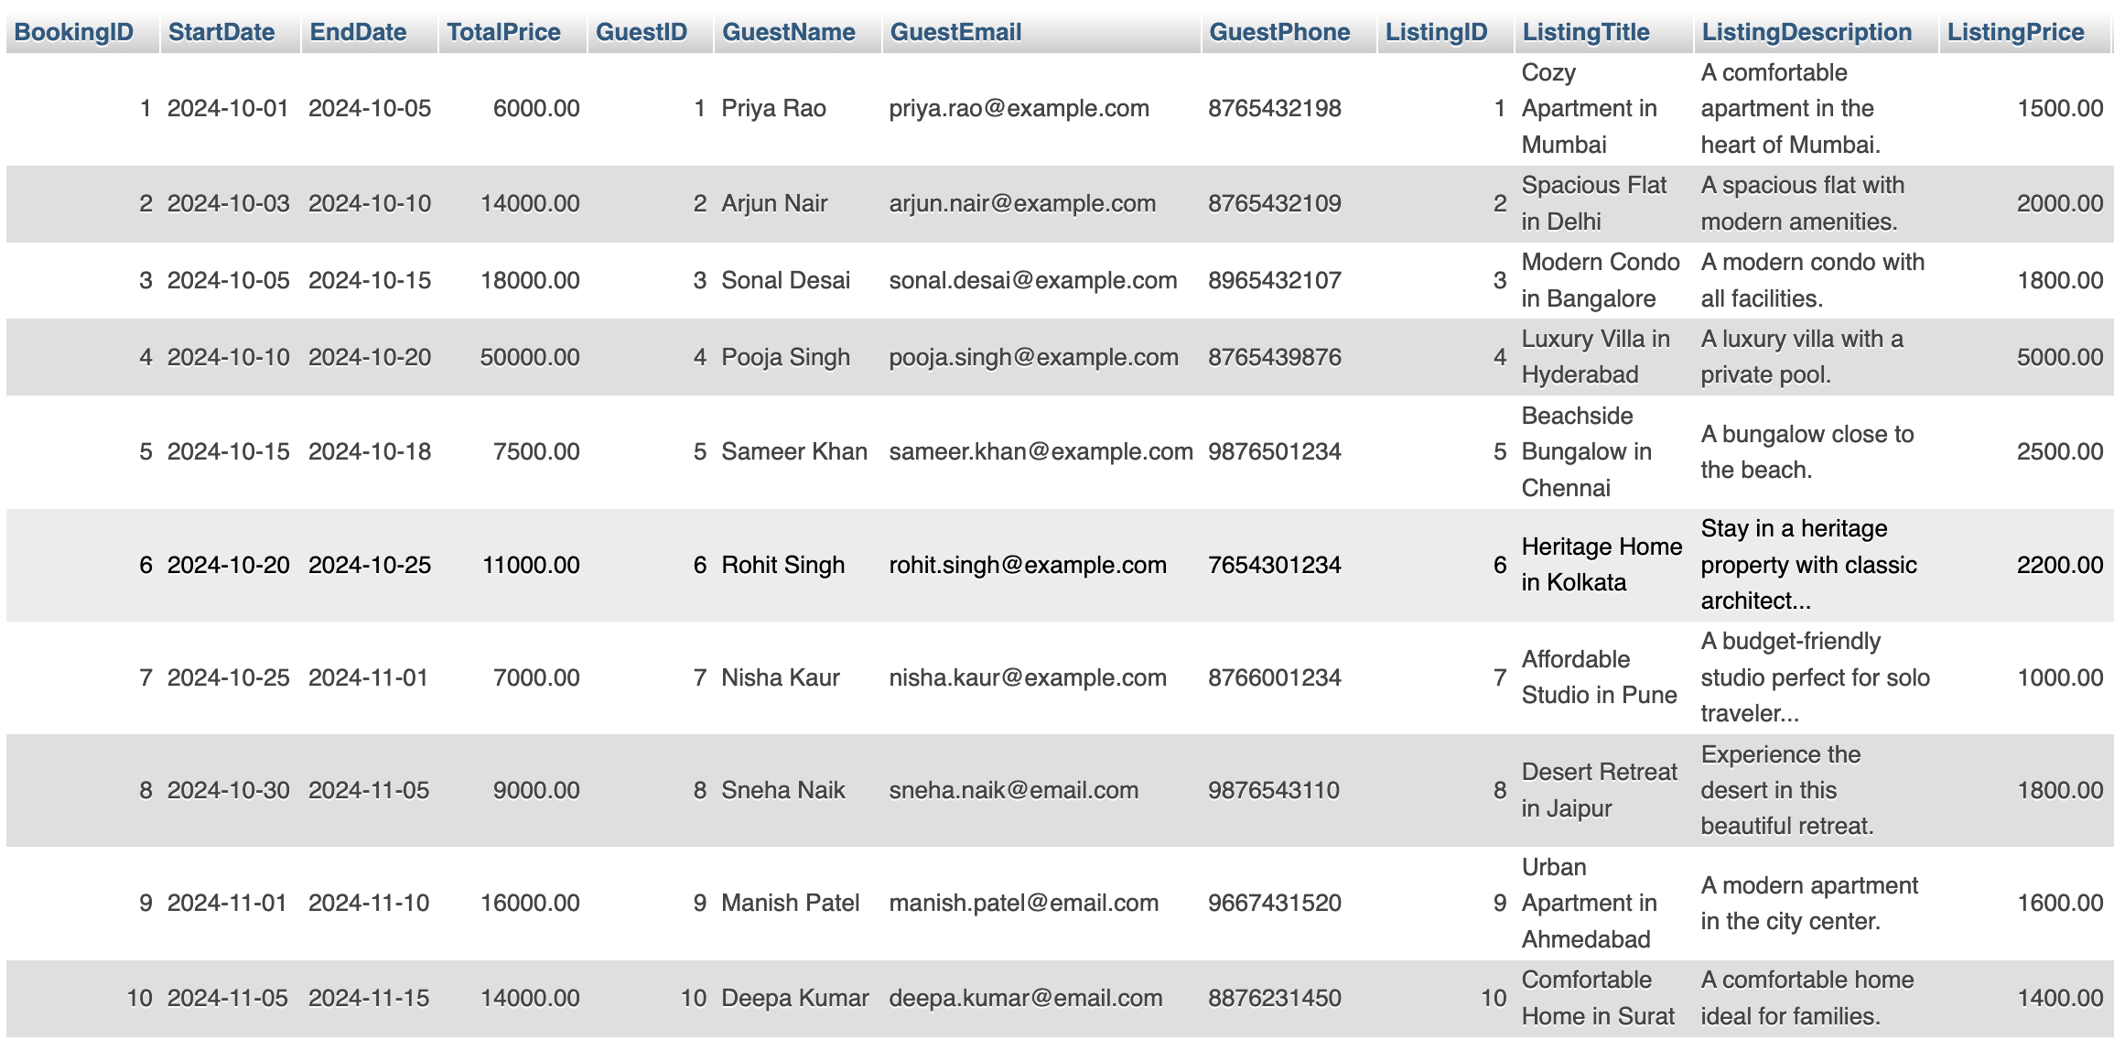
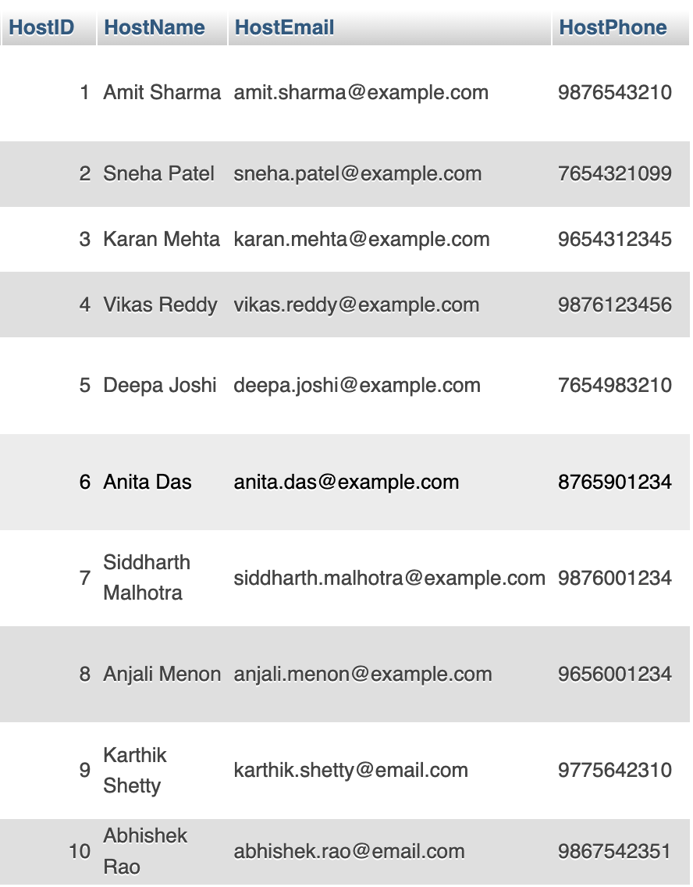
Booking: Test Case : To Show Booking Details
SELECT B.BookingID, B.StartDate, B.EndDate, B.TotalPrice,
G.GuestID, U.Name AS GuestName, U.Email AS GuestEmail, U.Phone AS GuestPhone,
L.ListingID, L.Title AS ListingTitle, L.Description AS ListingDescription, L.Price AS ListingPrice,
H.HostID, HU.Name AS HostName, HU.Email AS HostEmail, HU.Phone AS HostPhone
FROM Booking B
INNER JOIN Guest G ON B.GuestID = G.GuestID
INNER JOIN User U ON G.UserID = U.UserID -- Join to get guest's details
INNER JOIN Listing L ON B.ListingID = L.ListingID
INNER JOIN Host H ON L.HostID = H.HostID
INNER JOIN User HU ON H.UserID = HU.UserID; -- Join to get host's details
B.BookingID, B.StartDate, B.EndDate, B.TotalPrice: Retrieves booking details from the Booking table.
G.GuestID: Retrieves the guest ID from the Guest table.
U.Name, U.Email, U.Phone: Retrieves the guest's name, email, and phone from the User table.
L.ListingID, L.Title, L.Description, L.Price: Retrieves listing details from the Listing table.
H.HostID: Retrieves the corresponding HostID from the Host table.
HU.Name, HU.Email, HU.Phone: Retrieves the host's name, email, and phone from the User table (since the host is also a user).
This query will return booking details along with the corresponding guest and listing information, and it also includes the host's details.

Slide 21
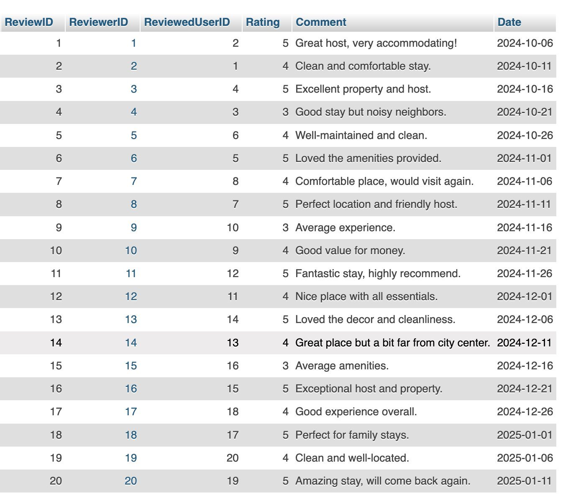
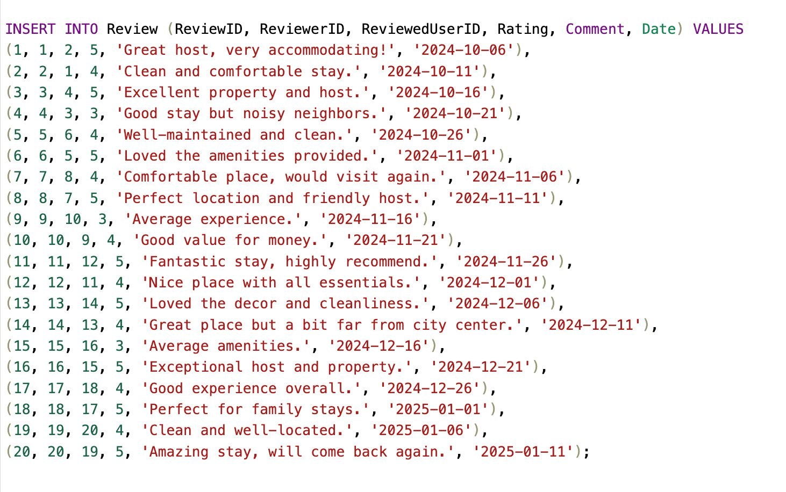
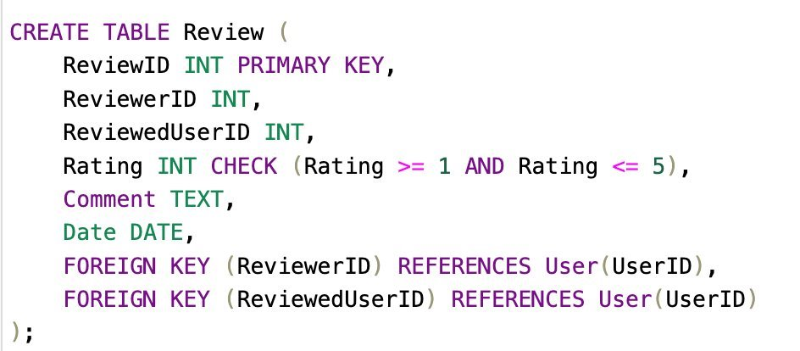
Review
Use the SQL statement Create Table to define the structure of the Review table
Use the SQL statement Insert Into 'Review' to insert the values in the Review table

Slide 22
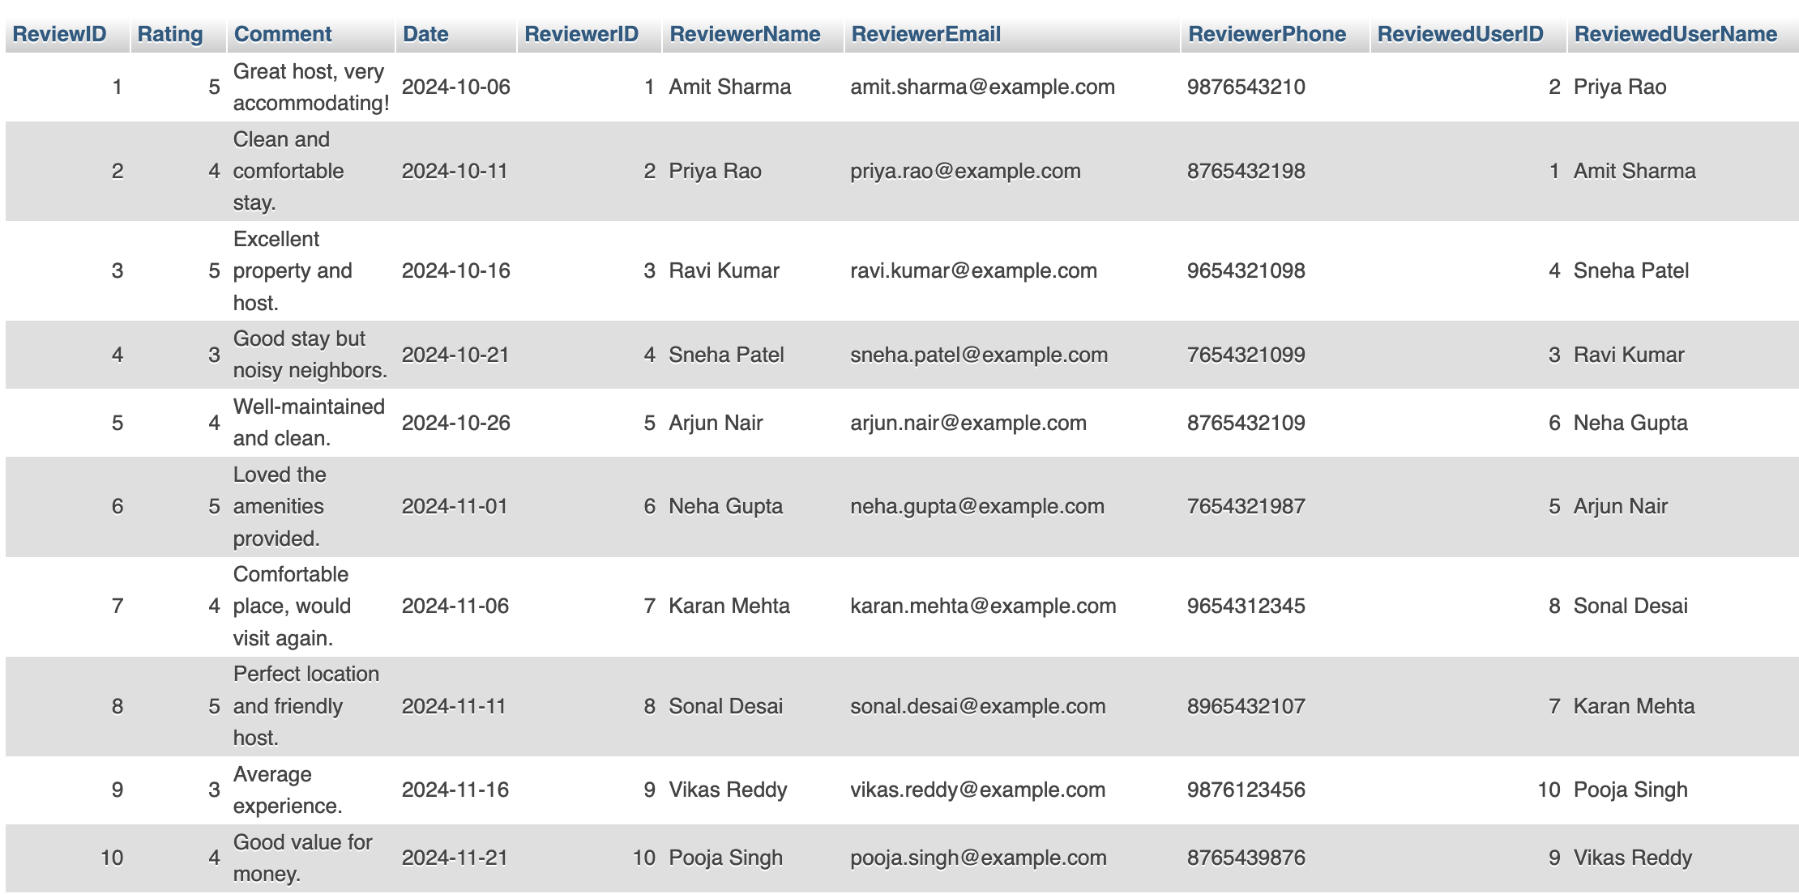
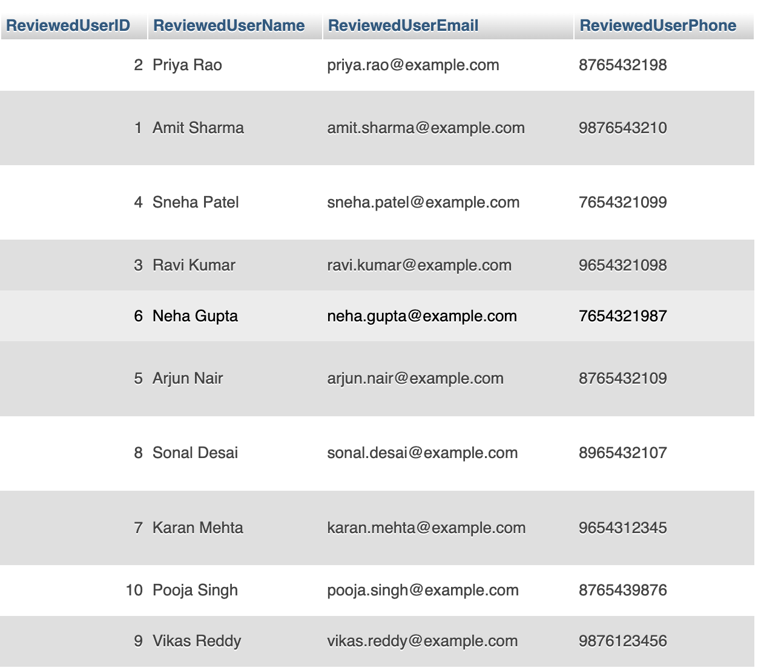
Review: Test Case : To Show Review Details
SELECT R.ReviewID, R.Rating, R.Comment, R.Date,
Reviewer.UserID AS ReviewerID, Reviewer.Name AS ReviewerName, Reviewer.Email AS ReviewerEmail, Reviewer.Phone AS ReviewerPhone,
ReviewedUser.UserID AS ReviewedUserID, ReviewedUser.Name AS ReviewedUserName, ReviewedUser.Email AS ReviewedUserEmail, ReviewedUser.Phone AS ReviewedUserPhone
FROM Review R
INNER JOIN User Reviewer ON R.ReviewerID = Reviewer.UserID INNER JOIN User ReviewedUser ON R.ReviewedUserID = ReviewedUser.UserID;
R.ReviewID, R.Rating, R.Comment, R.Date: Retrieves the review details from the Review table.
Reviewer.UserID, Reviewer.Name, Reviewer.Email, Reviewer.Phone: Retrieves the details of the reviewer from the User table.
ReviewedUser.UserID, ReviewedUser.Name, ReviewedUser.Email, ReviewedUser.Phone: Retrieves the details of the reviewed user from the User table.
This query will return each review along with information about both the reviewer and the user who was reviewed.

Slide 23
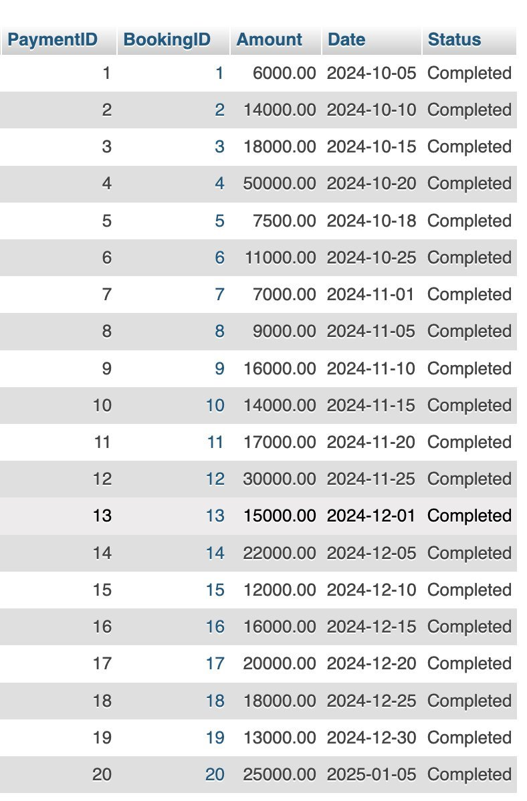
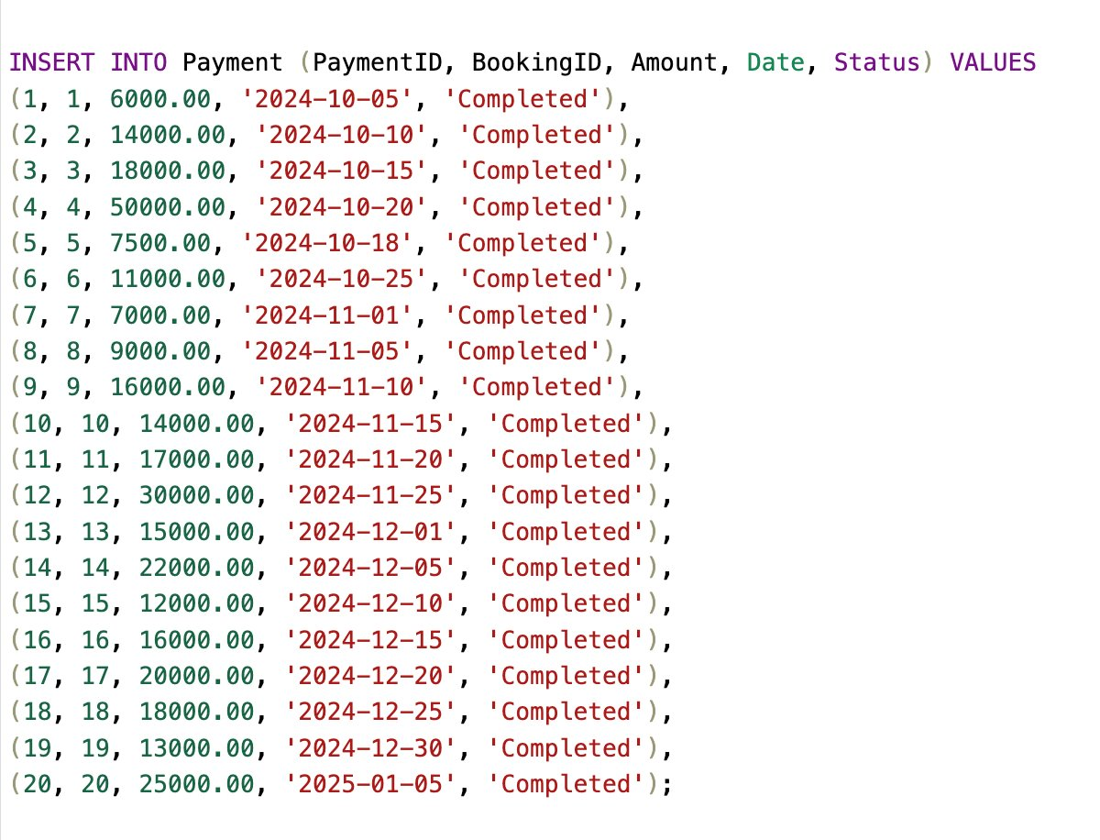
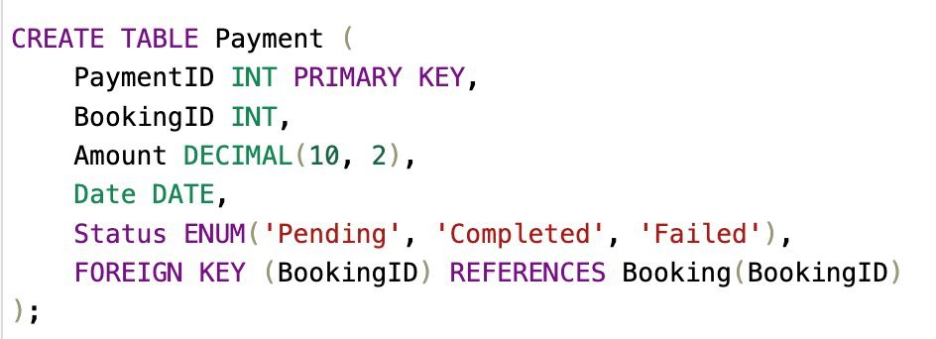
Payment
Use the SQL statement Create Table to define the structure of the Payment table
Use the SQL statement Insert Into 'Payment' to insert the values in the Payment table

Slide 24

Payment: Test Case : To Show Payment Details
SELECT P.PaymentID, P.Amount, P.Date, P.Status,
B.BookingID, B.StartDate, B.EndDate, B.TotalPrice,
G.GuestID, GuestUser.UserID AS GuestUserID, GuestUser.Name AS GuestName, GuestUser.Email AS GuestEmail, GuestUser.Phone AS GuestPhone
FROM Payment P
INNER JOIN Booking B ON P.BookingID = B.BookingID -- Join to get booking details
INNER JOIN Guest G ON B.GuestID = G.GuestID -- Join to get guest details
INNER JOIN User GuestUser ON G.UserID = GuestUser.UserID; -- Join to get guest user details
P.PaymentID, P.Amount, P.Date, P.Status: Retrieves the payment details from the Payment table.
B.BookingID, B.StartDate, B.EndDate, B.TotalPrice: Retrieves the booking details related to the payment from the Booking table.
G.GuestID: Retrieves the guest ID from the Guest table.
GuestUser.UserID, GuestUser.Name, GuestUser.Email, GuestUser.Phone: Retrieves the guest's user details from the User table.
This query returns the payment details along with information about the associated booking and guest.

Slide 25



SocialNetwork
Use the SQL statement Create Table to define the structure of the SocialNetwork table
Use the SQL statement Insert Into 'SocialNetwork' to insert the values in the SocialNetwork table

Slide 26

SocialNetwork: Test Case : To Show SocialNetwork Details
SELECT SN.SocialNetworkID,
SN.Name AS SocialNetworkName,
SN.URL AS SocialNetworkURL,
USN.UserSocialNetworkID,
USN.SocialNetworkProfileURL,
U.UserID,
U.Name AS UserName
FROM SocialNetwork SN
INNER JOIN UserSocialNetwork USN ON SN.SocialNetworkID = USN.SocialNetworkID -- Join with UserSocialNetwork
INNER JOIN User U ON USN.UserID = U.UserID; -- Join with User
SN.SocialNetworkID: The ID of the social network platform.
SN.Name, SN.URL: The name and URL of the social network platform.
USN.UserSocialNetworkID: The ID of the user’s social network profile.
USN.SocialNetworkProfileURL: The URL of the user's profile on the social network platform.
U.UserID, U.Name: The ID and name of the user associated with the social network profile.
This query provides a detailed view of social network platforms, the profiles linked to those platforms, and the users associated with those profiles.

Slide 27



UserSocialNetwork
Use the SQL statement Create Table to define the structure of the UserSocialNetwork table
Use the SQL statement Insert Into 'UserSocialNetwork' to insert the values in the UserSocialNetwork table

Slide 28

UserSocialNetwork: Test Case : To Show UserSocialNetwork Details
SELECT USN.UserSocialNetworkID,
U.UserID, U.Name AS UserName, U.Email AS UserEmail, U.Phone AS UserPhone,
SN.SocialNetworkID, SN.Name AS SocialNetworkName, SN.URL AS SocialNetworkURL,
USN.SocialNetworkProfileURL
FROM UserSocialNetwork USN
INNER JOIN User U ON USN.UserID = U.UserID -- Join to get user details
INNER JOIN SocialNetwork SN ON USN.SocialNetworkID = SN.SocialNetworkID; -- Join to get social network details
USN.UserSocialNetworkID: Retrieves the ID of the user’s social network entry from the UserSocialNetwork table.
U.UserID, U.Name, U.Email, U.Phone: Retrieves the user details from the User table.
SN.SocialNetworkID, SN.Name, SN.URL: Retrieves the social network details from the SocialNetwork table.
USN.SocialNetworkProfileURL: Retrieves the specific social network profile URL for the user.
This query shows which users are connected to which social networks along with their respective profile URLs.

Slide 29



Message
Use the SQL statement Create Table to define the structure of the Message table
Use the SQL statement Insert Into 'Message' to insert the values in the Message table

Slide 30

Message: Test Case : To Show Message Details
SELECT M.MessageID,
M.Content,
M.Timestamp,
Sender.UserID AS SenderID, Sender.Name AS SenderName, Sender.Email AS SenderEmail, Sender.Phone AS SenderPhone,
Receiver.UserID AS ReceiverID, Receiver.Name AS ReceiverName, Receiver.Email AS ReceiverEmail, Receiver.Phone AS ReceiverPhone
FROM Message M
INNER JOIN User Sender ON M.SenderID = Sender.UserID -- Join to get sender details
INNER JOIN User Receiver ON M.ReceiverID = Receiver.UserID; -- Join to get receiver details
M.MessageID: Retrieves the ID of the message from the Message table.
M.Content, M.Timestamp: Retrieves the message content and the timestamp of when the message was sent.
Sender.UserID, Sender.Name, Sender.Email, Sender.Phone: Retrieves the sender's details from the User table.
Receiver.UserID, Receiver.Name, Receiver.Email, Receiver.Phone: Retrieves the receiver's details from the User table.
This query shows all the messages, along with detailed information about both the sender and receiver.

Slide 31



Amenity
Use the SQL statement Create Table to define the structure of the Amenity table
Use the SQL statement Insert Into 'Amenity' to insert the values in the Amenity table

Slide 32

Amenity: Test Case : To Show Amenity Details
SELECT A.AmenityID,
A.Name AS AmenityName,
L.ListingID,
L.Title AS ListingTitle,
L.Description AS ListingDescription,
L.Price AS ListingPrice,
L.Location AS ListingLocation
FROM Amenity A
INNER JOIN ListingAmenity LA ON A.AmenityID = LA.AmenityID -- Join to get the relationship between Amenity and Listing
INNER JOIN Listing L ON LA.ListingID = L.ListingID; -- Join to get listing details
A.AmenityID, A.Name: Retrieves the ID and name of the amenity from the Amenity table.
L.ListingID, L.Title, L.Description, L.Price, L.Location: Retrieves the listing details associated with the amenity from the Listing table through the ListingAmenity relationship table.
This query returns all amenities along with the corresponding listings that have those amenities.

Slide 33



ListingAmenity
Use the SQL statement Create Table to define the structure of the ListingAmenity table
Use the SQL statement Insert Into 'ListingAmenity' to insert the values in the ListingAmenity table

Slide 34

ListingAmenity: Test Case : To Show ListingAmenity Details
SSELECT LA.ListingAmenityID,
L.ListingID,
L.Title AS ListingTitle,
L.Description AS ListingDescription,
L.Price AS ListingPrice,
L.Location AS ListingLocation,
A.AmenityID,
A.Name AS AmenityName
FROM ListingAmenity LA
INNER JOIN Listing L ON LA.ListingID = L.ListingID -- Join to get listing details
INNER JOIN Amenity A ON LA.AmenityID = A.AmenityID; -- Join to get amenity details
LA.ListingAmenityID: The unique ID for the listing amenity relationship.
L.ListingID, L.Title, L.Description, L.Price, L.Location: Retrieves listing details from the Listing table.
A.AmenityID, A.Name: Retrieves amenity details from the Amenity table.
This query will return all the listings along with their associated amenities, showing the details of both.

Slide 35



Maintenance
Use the SQL statement Create Table to define the structure of the Maintenance table
Use the SQL statement Insert Into 'Maintenance' to insert the values in the Maintenance table

Slide 36

Maintenance: Test Case : To Show Maintenance Details
SELECT M.MaintenanceID,
M.Description AS MaintenanceDescription,
M.DateScheduled,
M.Status,
L.ListingID,
L.Title AS ListingTitle,
H.HostID,
U.Name AS HostName,
C.Name AS CityName
FROM Maintenance M
INNER JOIN Listing L ON M.ListingID = L.ListingID -- Join with Listing
INNER JOIN Host H ON L.HostID = H.HostID -- Join with Host
INNER JOIN User U ON H.UserID = U.UserID -- Join with User (Host details)
INNER JOIN City C ON L.CityID = C.CityID; -- Join with City
M.MaintenanceID, M.Description, M.DateScheduled, M.Status: Fetches the maintenance details.
L.ListingID, L.Title: Fetches listing information from the Listing table.
H.HostID, U.Name: Retrieves the host details using the Host and User tables.
C.Name: Retrieves the city name associated with the listing.
This query retrieves information from Maintenance, Listing, Host, User, and City tables. It gives a comprehensive view of maintenance along with its listing, host, and city details.

Slide 37



ListingPhoto
Use the SQL statement Create Table to define the structure of the ListingPhoto table
Use the SQL statement Insert Into 'ListingPhoto' to insert the values in the ListingPhoto table

Slide 38

ListingPhoto: Test Case : To Show ListingPhoto Details
SELECT LP.ListingPhotoID,
LP.PhotoURL AS ListingPhoto,
L.ListingID,
L.Title AS ListingTitle,
H.HostID,
U.Name AS HostName,
C.Name AS CityName
FROM ListingPhoto LP
INNER JOIN Listing L ON LP.ListingID = L.ListingID -- Join with Listing
INNER JOIN Host H ON L.HostID = H.HostID -- Join with Host
INNER JOIN User U ON H.UserID = U.UserID -- Join with User (Host details)
INNER JOIN City C ON L.CityID = C.CityID; -- Join with City
LP.ListingPhotoID, LP.PhotoURL: Fetches the photo information from the ListingPhoto table.
L.ListingID, L.Title: Retrieves the associated listing details.
H.HostID, U.Name: Retrieves the host details by joining the Host and User tables.
C.Name: Fetches the city name for the listing.
This query provides information from the ListingPhoto, Listing, Host, User, and City tables. It pulls data about the photo, the listing it belongs to, the host responsible for the listing, and the city where the listing is located.

Slide 39



Coupon
Use the SQL statement Create Table to define the structure of the Coupon table
Use the SQL statement Insert Into 'Coupon' to insert the values in the Coupon table

Slide 40

Coupon: Test Case : To Show Coupon Details
SELECT C.CouponID,
C.Code AS CouponCode,
C.DiscountPercentage,
B.BookingID,
G.GuestID,
U.Name AS GuestName,
L.ListingID,
L.Title AS ListingTitle
FROM Coupon C
INNER JOIN BookingCoupon BC ON C.CouponID = BC.CouponID -- Join with BookingCoupon
INNER JOIN Booking B ON BC.BookingID = B.BookingID -- Join with Booking
INNER JOIN Guest G ON B.GuestID = G.GuestID -- Join with Guest
INNER JOIN User U ON G.UserID = U.UserID -- Join with User (Guest details)
INNER JOIN Listing L ON B.ListingID = L.ListingID; -- Join with Listing
C.CouponID, C.Code, C.DiscountPercentage: Fetches the coupon details.
B.BookingID: Retrieves the associated booking.
G.GuestID, U.Name: Retrieves the guest details by joining Guest and User tables.
L.ListingID, L.Title: Fetches the listing details associated with the booking.
This query provides information about the coupon, booking, guest, and listing by joining multiple related tables.

Slide 41



BookingCoupon
Use the SQL statement Create Table to define the structure of the BookingCoupon table
Use the SQL statement Insert Into 'BookingCoupon' to insert the values in the BookingCoupon table

Slide 42

BookingCoupon: Test Case : To Show BookingCoupon Details
SELECT BC.BookingCouponID,
B.BookingID,
G.GuestID,
U.Name AS GuestName,
C.CouponID,
C.Code AS CouponCode,
C.DiscountPercentage,
B.TotalPrice
FROM BookingCoupon BC
INNER JOIN Booking B ON BC.BookingID = B.BookingID -- Join with Booking
INNER JOIN Guest G ON B.GuestID = G.GuestID -- Join with Guest
INNER JOIN User U ON G.UserID = U.UserID -- Join with User (Guest details)
INNER JOIN Coupon C ON BC.CouponID = C.CouponID; -- Join with Coupon
BC.BookingCouponID: The ID of the BookingCoupon.
B.BookingID: The booking associated with the coupon.
G.GuestID, U.Name: The guest details by joining the Guest and User tables.
C.CouponID, C.Code, C.DiscountPercentage: The coupon details applied to the booking.
B.TotalPrice: The total price of the booking.
This query provides comprehensive details about the booking, guest, and coupon used, by joining multiple related tables.

Slide 43



TransactionHistory
Use the SQL statement Create Table to define the structure of the TransactionHistory table
Use the SQL statement Insert Into 'TransactionHistory' to insert the values in the TransactionHistory table

Slide 44

TransactionHistory: Test Case : To Show TransactionHistory Details
SELECT TH.TransactionID,
U.UserID,
U.Name AS UserName,
P.PaymentID,
P.Amount AS PaymentAmount,
P.Status AS PaymentStatus,
B.BookingID,
B.TotalPrice AS BookingTotalPrice,
TH.TransactionDate,
TH.Amount AS TransactionAmount,
TH.Status AS TransactionStatus
FROM TransactionHistory TH
INNER JOIN User U ON TH.UserID = U.UserID -- Join with User
INNER JOIN Payment P ON TH.PaymentID = P.PaymentID -- Join with Payment
INNER JOIN Booking B ON TH.BookingID = B.BookingID; -- Join with Booking
TH.TransactionID: The ID of the transaction.
U.UserID, U.Name: The user details involved in the transaction.
P.PaymentID, P.Amount, P.Status: Payment details such as the amount and payment status.
B.BookingID, B.TotalPrice: Booking details related to the transaction.
TH.TransactionDate, TH.Amount, TH.Status: The date, amount, and status of the transaction.
This query joins the TransactionHistory table with User, Payment, and Booking tables, providing a comprehensive overview of the transactions, including the user, payment, and booking details.

Slide 45

Updated ERM

Slide 46
Thank You

